Slide 1
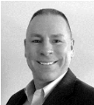
Topic:
Chapter Meeting – November 2019
SE: Cracking the Code of Digital Transformation
Presenter:
Troy Peterson
Vice President & Technical Fellow
System Strategy, Inc. (SSI)
Presentation Site:
Remote
Date:
Thursday, November 21, 2019
Agenda:
6:00 - 6:30 PM CT – Dinner & Networking
6:30 - 6:45 PM CT – Announcements & Introductions
6:45 - 7:00 PM CT – Mini-Presentation: Small Business Systems Engr (SBSE) Working Group
Angela D. Robinson, MBA, ASEP, PMP
7:00 - 8:15 PM CT – Feature Presentation and Q&A
Abstract
While complex systems transform the landscape, the systems engineering discipline is also experiencing a transformation to a model-based discipline. In alignment with this, the International Council on Systems Engineering (INCOSE) is strategically accelerating this transformation by building a broad community that promotes and advances model-based methods to manage the high rate of change and complexity of systems today. This presentation addresses contextual drivers for transformation, describes INCOSE activities aligned with accelerating the transformation, and makes the case that model-based systems engineering can help businesses crack the code of Digital Transformation as it pertains to innovation.
About Our Speaker
Troy Peterson, SSI Vice President, and INCOSE Transformation and FUTURE lead is a recognized leader in developing model based solutions to speed innovation and solve complex systems challenges. He has led the delivery of numerous complex systems and methodologies while at SSI, Booz Allen and Ford Motor Company. His experience spans academic, non-profit, commercial and government environments across all lifecycle phases. Troy received a BS in Mechanical Engineering from Michigan State University, an MS in Technology Management from Rensselaer Polytechnic Institute, and an advanced graduate certificate in Systems Design and Management from the Massachusetts Institute of Technology. He also holds INCOSE CSEP, PMI PMP, and ASQ Six Sigma Black Belt Certifications.
Questions?
For more information, go to http://www.incose.org/Chicagoland/.

Slide 2
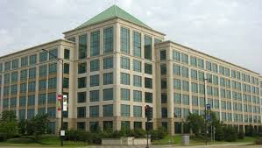
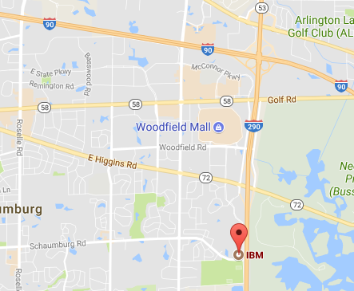
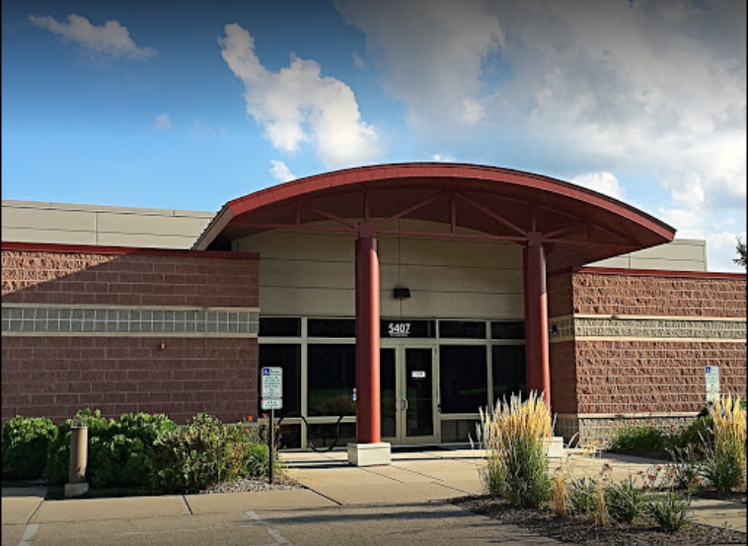
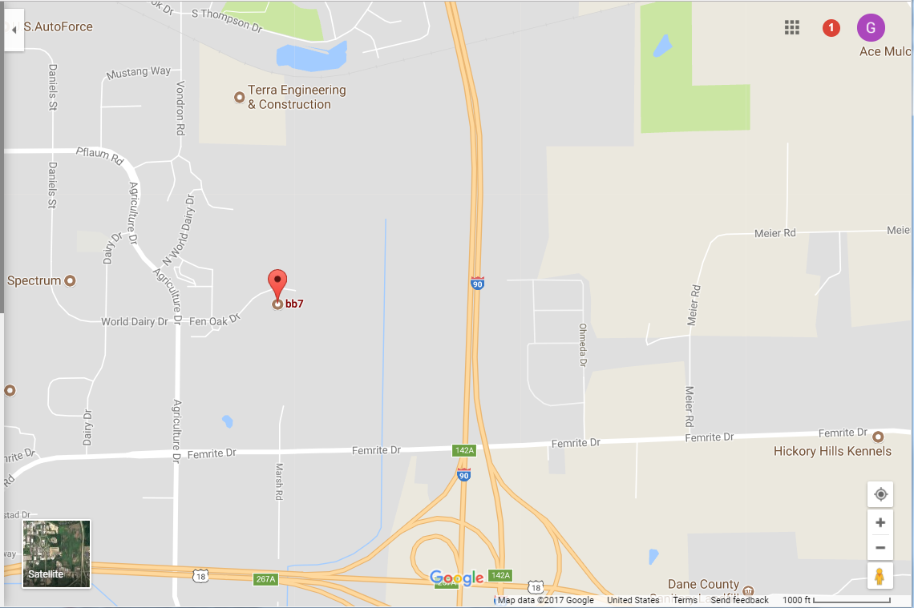
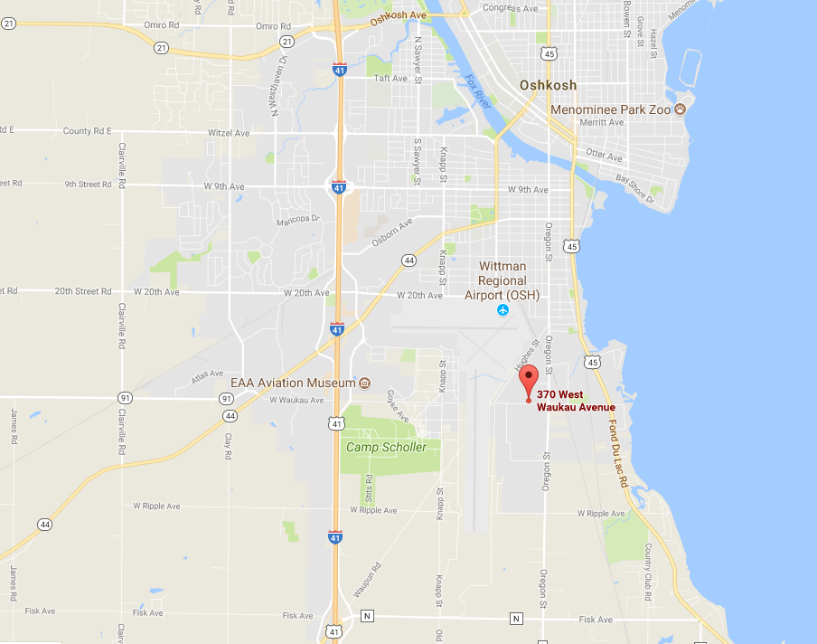
Topic:
Chapter Meeting – November 2019
SE: Cracking the Code of Digital Transformation
Presenter:
Troy Peterson
Vice President & Technical Fellow
System Strategy, Inc. (SSI)
Presentation Site:
Remote
Attend / network at one of the physical sites listed below, or attend remotely
IBM offices, 10 N. Martingale Rd.
Schaumburg, IL 60173
3rd Floor Conference Room
BB7, 5407 Fen Oak Dr.
Madison, WI 53718
Mendota Conference Room
Attend live, on-line. Meeting begins at 6:30 PM CT.
Video URL:
https://incose.pgimeet.com/INCOSEResourceTwelve
Audio Dial-In: Access Number: 1-605-475-5604 Guest Passcode: 723 236 7062
Oshkosh Corp (Limited to Oshkosh Employees)
370 W. Waukau Ave
Oshkosh, WI 54902
Questions?
For more information, go to http://www.incose.org/Chicagoland/.

