Slide 1
More Effective Planning Using Agile and Lean Approaches
INCOSE North Texas Chapter
December 16, 2015

Slide 2
Poll Experience
What Experience Have You Had
SWOT
Strategic Planning
Product Planning
Project Planning
Department / Operational Planning
Business/Marketing Planning

Slide 3
Planning Examples
Project Planning:
Purchase a car for the family
Plan a family camping trip
Build a doghouse for the family dog
Plan a planning workshop for INCOSE IW 2016
Strategic Planning:
A strategic plan to increase family income
Planning for education/training of children high school and after
Create a vibrant industry or academic partnership for an INCOSE chapter

Slide 4
Critical Mistakes
Focusing on the Plan document as the objective
No clear focus of the Critical Need – what is the problem
No Strategic Vision; No Shared Vision
Not developed by the team that will execute

Slide 5
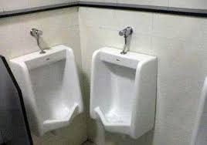
What Are Some Possible Reasons For these Planning Mistakes?
Notes:
Intelligence Challenged
Poor Planning
Poor Coordination
Lack of Communications
Vicious Compliance

Slide 6
Why Plan?
Harvard Business School found:
"2 out of 3 HR and IT departments develop plans that are not linked to the company's overall strategy".
"Most devastatingly, 95% of employees do not understand their company's strategy. (How are they supposed to execute a plan if they don't understand it?)"

Slide 7
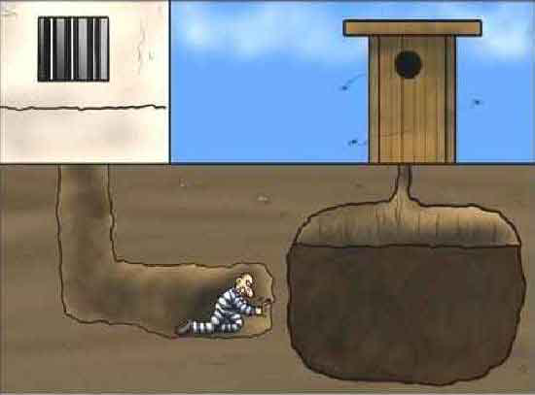
Why Plan for Chapters?
Provide maximum value to members
Align the leadership team – get all on the same page
Reduce stress, panics, and glitches throughout the year
Continuity - plans accommodate sudden changes in leadership
Makes it easier to bring in new leadership team members
And – reduce the probability of a disaster

Slide 8
Strategic vs Operational Planning
What’s the difference?
Strategic planning envisions the future and develops an approach to achieve that future
Strategic planning is worthless - unless there is first a strategic vision that is shared among the leadership.
Strategic plans define the vision of you want to achieve and provides the context for Operational planning
Operational plans are the incremental steps to achieve your Strategic plans.

Slide 9
What Are Some Elements Common to Plans
Stakeholders
Resources
Vision/Mission/Concept/
Financial/Budget
Schedule
Goals/Objectives
Risks Assessment/Contingencies
Tasks/Responsibilities

Slide 10
“Big Picture” Chart
3 – 5 Years
Strategies
Driving Issues
Values
This Year!

Slide 11
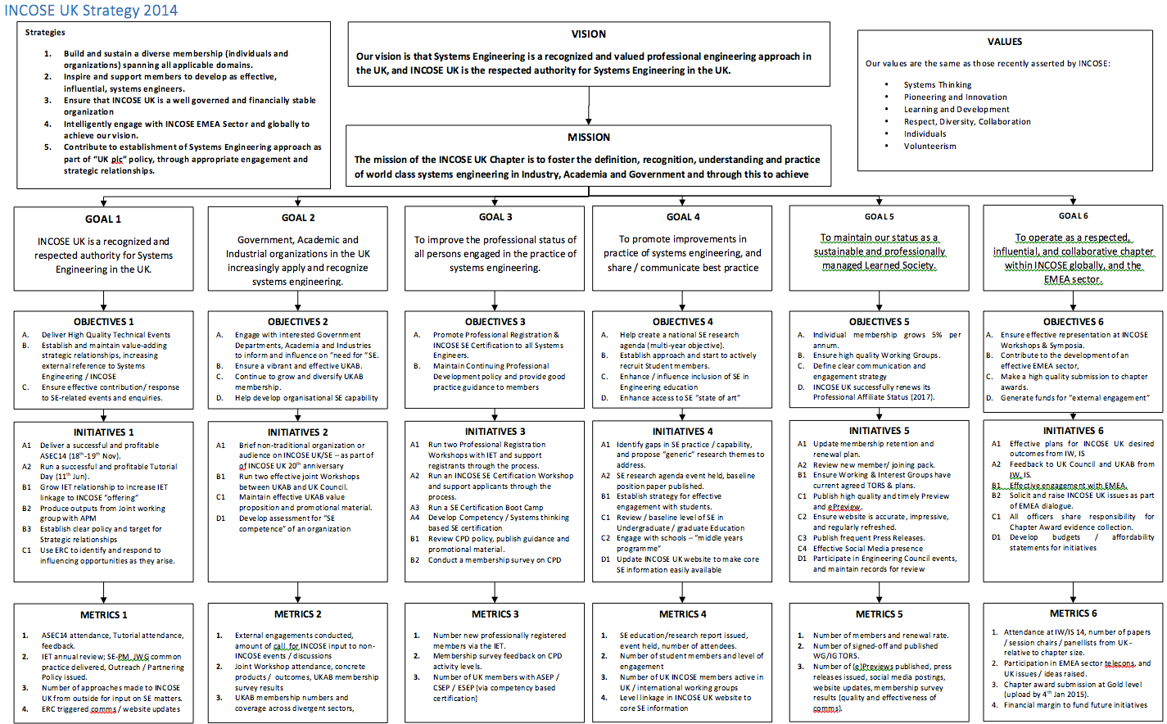

Slide 12
INCOSE Mission and Vision - Developed as Part of a Planning Process
Mission
Share, promote and advance the best of systems engineering from across the globe for the benefit of humanity and the planet.
Vision
The world's authority on Systems Engineering.
Goals
To provide a focal point for dissemination of systems engineering knowledge.
To promote international collaboration in systems engineering practice, education, and research.
To assure the establishment of competitive, scalable professional standards in the practice of systems engineering.
To improve the professional status of all persons engaged in the practice of systems engineering.
To encourage governmental and industrial support for research and educational programs that will improve the systems engineering process and its practice.

Slide 13
Chapter Strategic Planning
Base plans on what your members most value
Find out through member surveys or town hall meetings
Use a SWOT analysis to get things rolling
Ensure the leadership team is involved & also consider inviting all members to participate – nobody knows everything; nobody knows nothing
Create a shared Vision of what you want your chapter to be
Set measurable Goals for the next 5 years

Slide 14
Operational Planning
Details of activities for the coming year based on Vision and Goals set out in the Strategic Plan.
Include roles & responsibilities, schedule and budget.
Plans are a living document with updates to be done iteratively, refining details throughout the year.

Slide 15
Getting Started
For Projects, a Mission Analysis has usually been done and you are working to a Contract Specification
For other initiatives, start with a basic assessment to determine objectives and priorities
Conduct a SWOT
Survey stakeholders

Slide 16
Gathering Input
Stakeholder Survey and SWOT are excellent tools to gather initial inputs which can be used throughout
For Critical Need and Values, facilitated discussion can be beneficial
For SWOT, Vision, Mission, etc, it is helpful to conduct a democratic process where all actually participate in contributing ideas and shaping the results minimizing the opportunity for one or two strong personalities to dominate the process
Use Sticky Notes

Slide 17
Conduct SWOT Brief Exercise
Sticky Note rules
One idea per note
Complete sentences
Write legibly, preferably print
Affinitize/group similar ideas
Summarize each set of grouped ideas

Slide 18
Critical Need Discussion Brief Exercise
Facilitated
Capture on poster chart/white board
Don’t wordsmith at this point

Slide 19
Basic Planning Steps
Project Planning
Objectives/Top Level Requirements in Contract or Charter
Action Steps to Accomplish Objectives
Refine Requirements
Top Level Budget & Schedule
Specific Tasks
Tasks’ Budgets and Schedules
Performance Metrics

Slide 20
Basic Planning Steps
Organizational Planning (Business Unit/Chapter)
Critical Need
Vision/Mission
Values
Goals (long term, typically > 3 years)
Strategy
Objectives (current year) leading to goals
Constraints – Budget, Schedule, Resources
Action Steps to Accomplish Objectives
Performance Metrics

Slide 21
Chapter Operational Planning
Chapter events - Meetings/tutorials/activities
Chapter communications – website(s), emails, social media, newsletters
Membership – recruiting and retention, student division

Slide 22
Systematic Approach for Chapters
There are so many great possibilities for your chapter you can get overwhelmed
Ask participants to prepare beforehand
Consider separate sessions for Strategic and Operational planning
Tools to help
Chapter Planning Workbook & Template found on the Wiki
Example plans, how-to’s found on the Wiki

Slide 23
Chapter Planning Workbook
The Workbook includes most everything that could be done, so needs to be tailored to fit your chapter
Organized around the Chapter Awards criteria
The Introduction discusses planning methodology
The Workbook has suggestions and worksheets to fill in for all the different topics during your planning session
Assign responsibilities, budget, deadlines

Slide 24
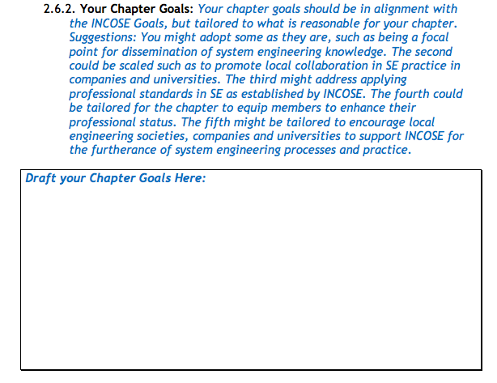
Chapter Planning Workbook Sample

Slide 25
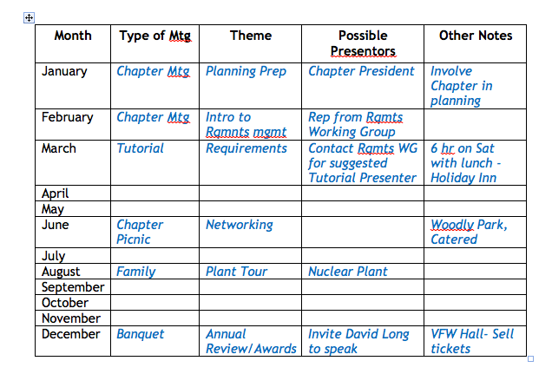
Chapter Planning Workbook Sample

Slide 26
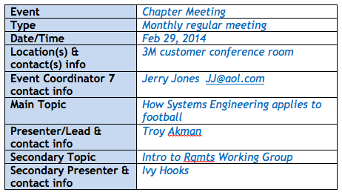
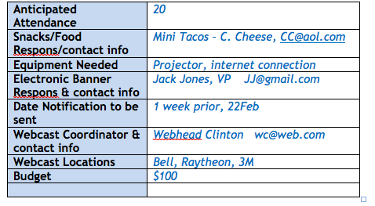
Chapter Planning Workbook Sample

Slide 27
Questions?

