Slide 1
Overview of the Office of the Deputy Assistant Secretary of Defense (ODASD)
Digital Engineering Strategy
Barry Papke
12 Feb 2019
INCOSE North Texas Chapter

Slide 2
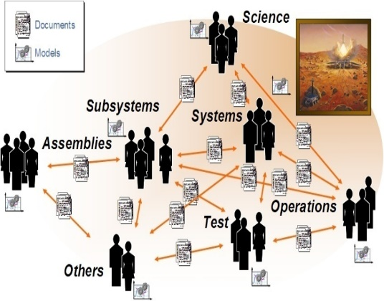
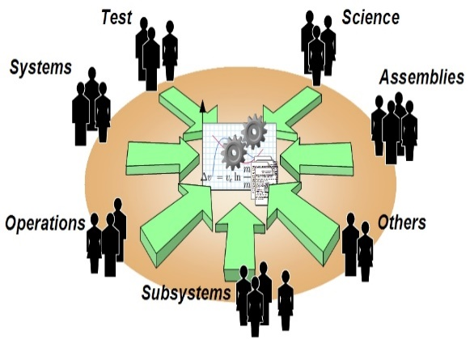
What Do We Mean When We Say MBSE?
Model Based Systems Engineering
Language
Methodology
Tool
Model Based vs Document Based
Model/data repository provides a single source of truth!

Slide 3
Industry Goals for MBSE
Reduce Development Cost and Design Cycle time
Eliminate of Wasted Effort
Facilitate Knowledge Transfer
Common Syntax and Semantics
Single Source of Truth
Manage Increased Complexity
Increase Reuse
Reduce Rework
Graphic Representation
Views and Viewpoints
Automated Validation and Analysis
Pulling the Digital Thread

Slide 4
Continuing Industry Challenges
Contracts and Legal
RFPs still document based (CDRLs, etc)
Collaboration Up/Down
Firewalls/Security/Trust
IP Protection
Infrastructure and Environment
Limited or No Standards
Trailing Infrastructure
Culture
Young vs Old
Tool Integration
Model Portability
Education and Training

Slide 5
How do we get there?

Slide 6
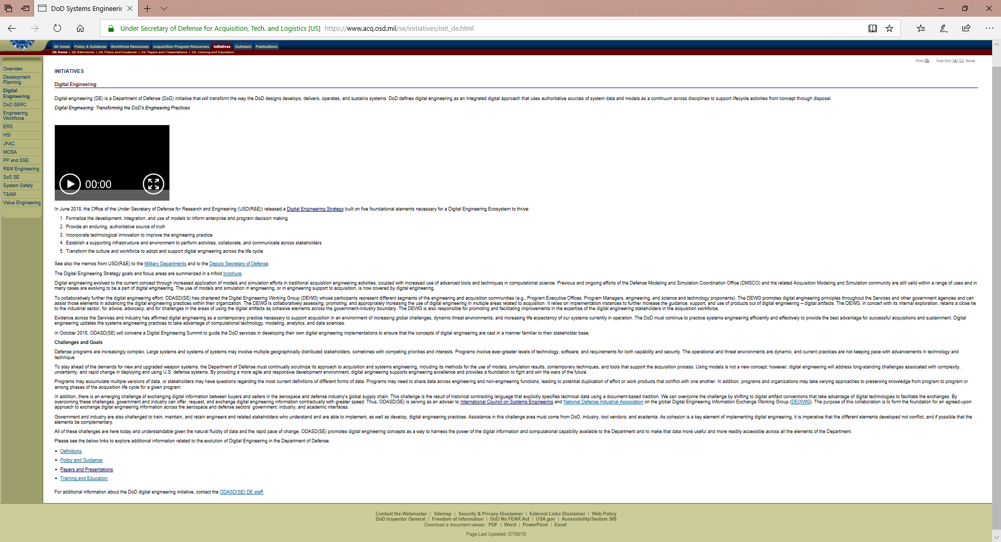
https://www.acq.osd.mil/se/initiatives/init_de.html

Slide 7
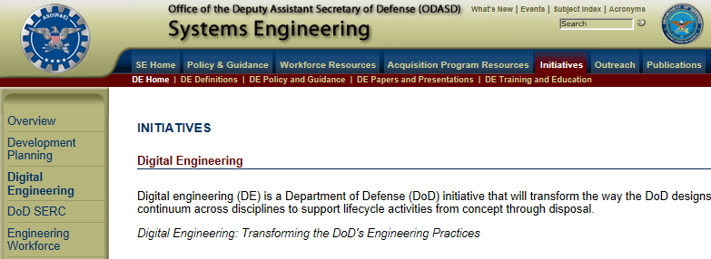
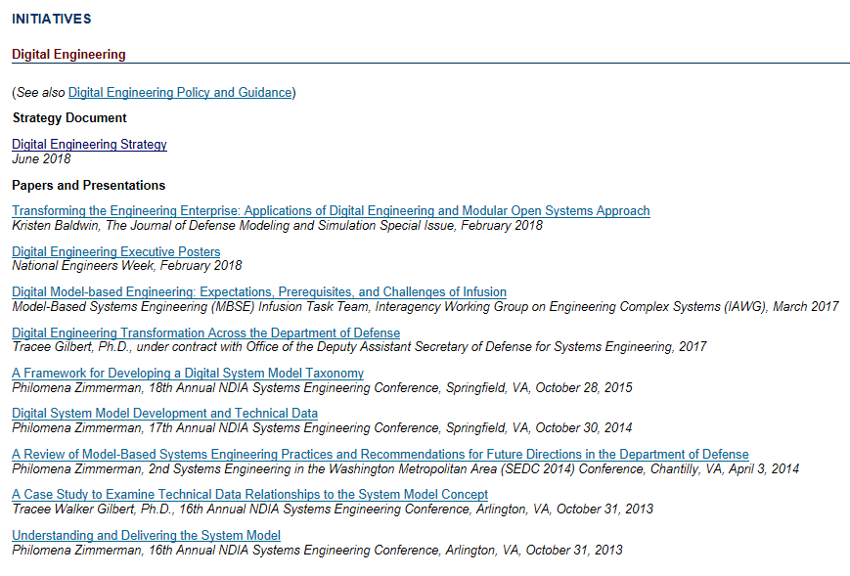
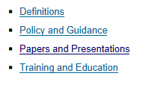

Slide 8
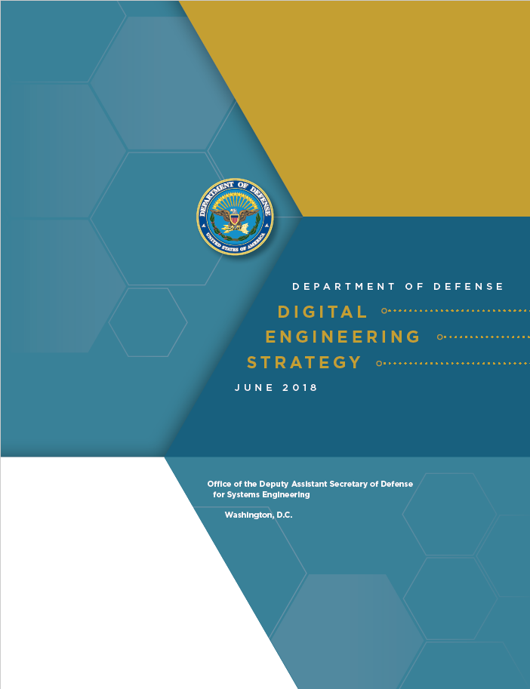
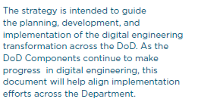
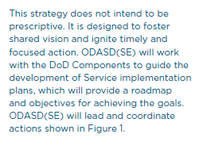
5 Strategic Goals

Slide 9
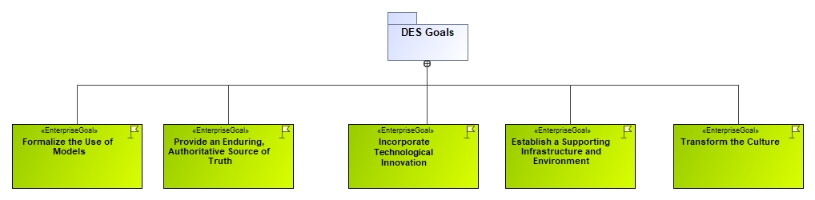
5 DES Goals

Slide 10
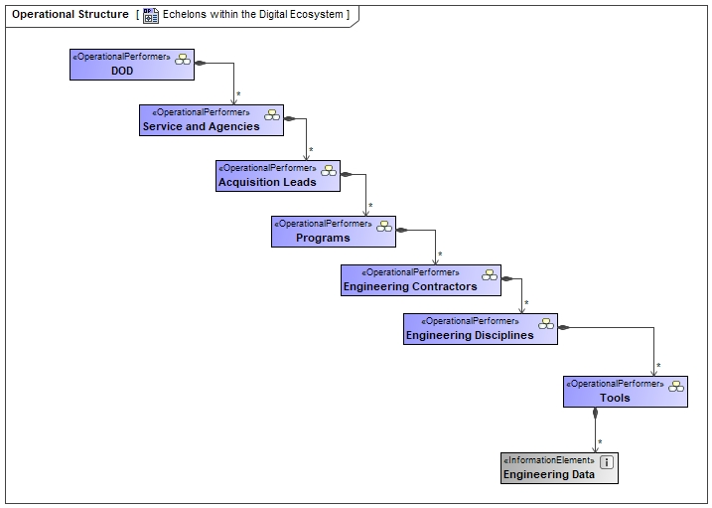
Its bigger than just Systems Engineering!!

Slide 11
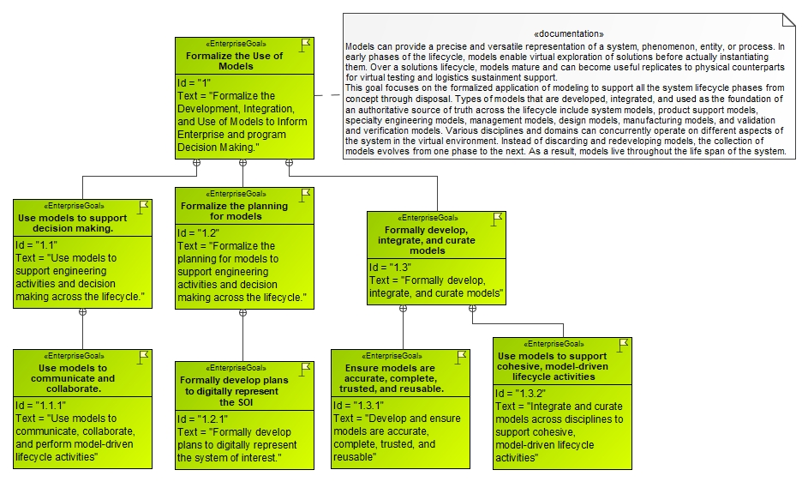
Goal #1 – Formalize the Use of Models

Slide 12
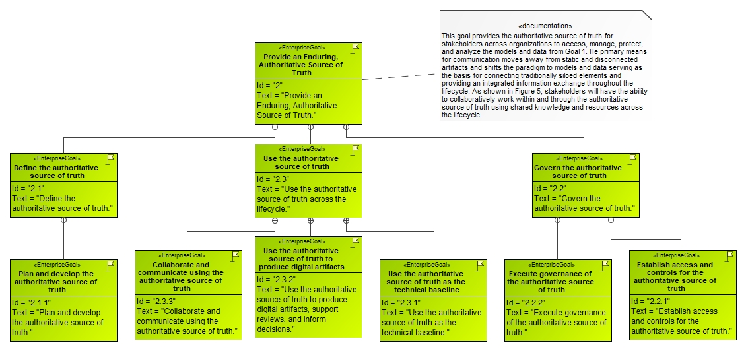
Goal #2 – Provide an Enduring Authoritative Source of Truth

Slide 13
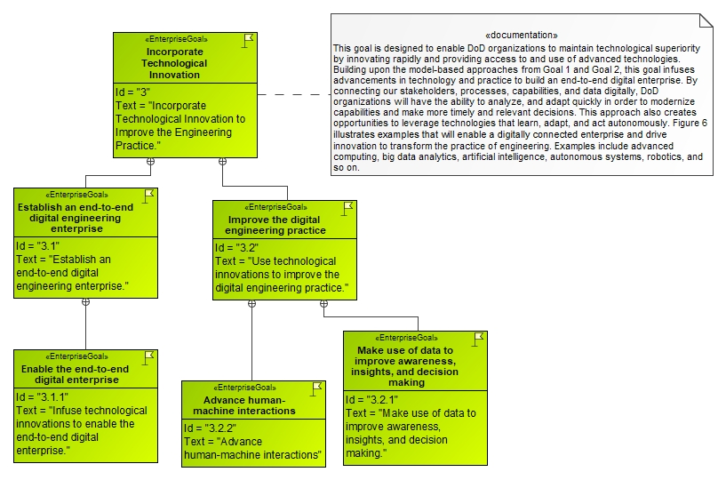
Goal # 3 – Incorporate Technological Innovation

Slide 14
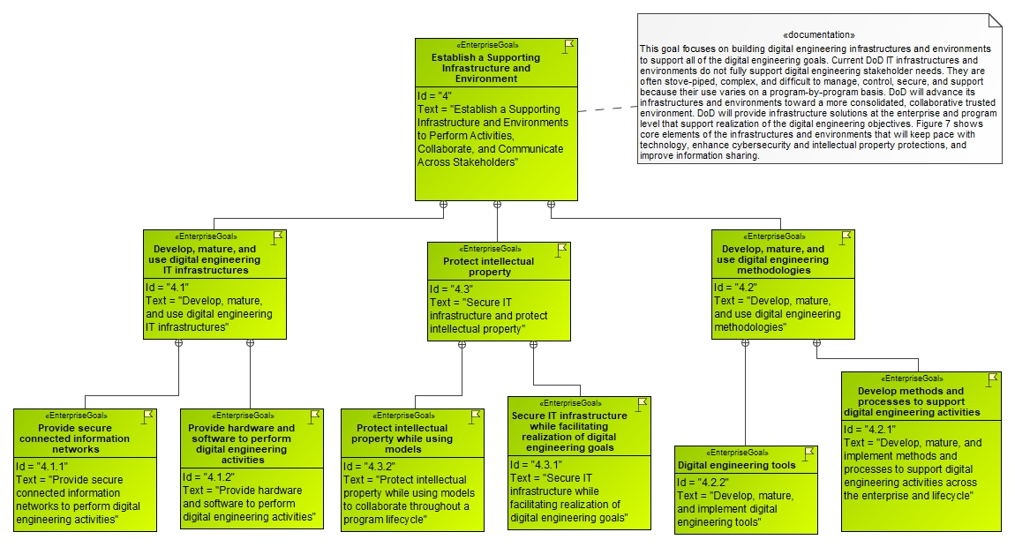
Goal # 4 – Establish a Supporting Infrastructure and Environment

Slide 15
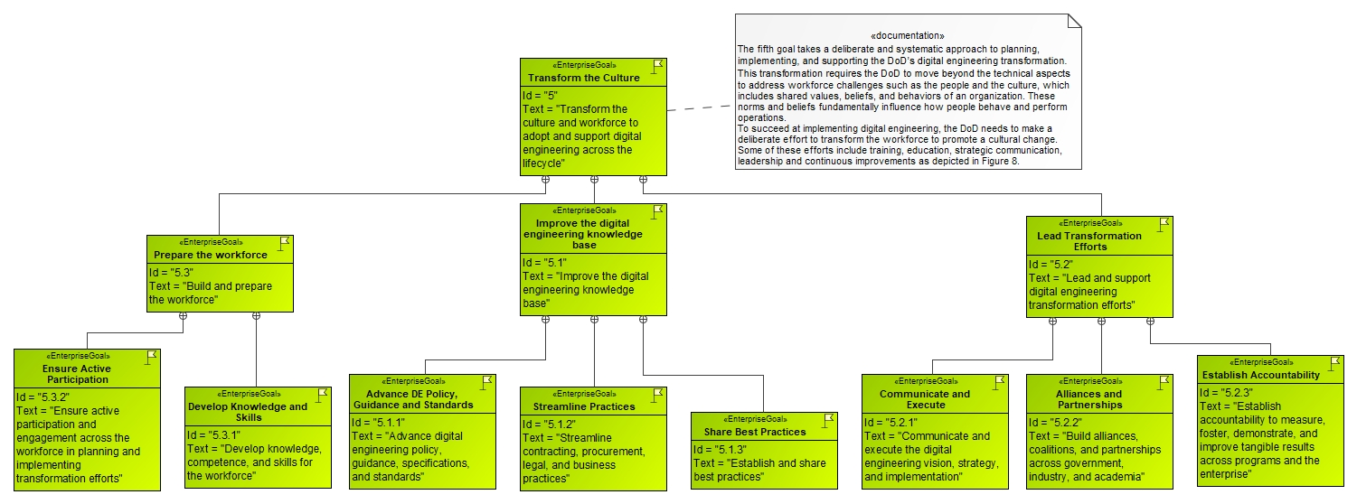
Goal 5 – Transform the Culture

Slide 16
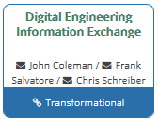
How is INCOSE involved
Digital Engineering Information Exchange Working Group
  The DEIX WG primary goal is to establish a finite set of digital artifacts that acquiring organizations and their global supply chains should use to request an exchange with each other as well as internally between teams/organizational elements. The following goals support this primary goal:
  Goal 1 – Define a Finite Set of Digital Artifacts: Define a finite set of digital artifacts that take advantage of digital technology to satisfy stakeholders’ information needs as it relates to systems engineering lifecycle standards such as ISO/IEC/IEEE 15288, 15289, 15504-6, 12207, 26531 and 24748.
  Goal 2 – Develop Constructs for assembling Digital Artifacts: A set of constructs and conventions that define how to select, compile, and analyze digital artifacts to produce digital engineering content for stakeholders.
  Goal 3 – Identify, Leverage and Influence Standards to Improve Digital Artifact Exchange: To use the understanding of existing and missing DEIX related standards literature to evolve a consensus-based standards framework for a Digital Engineering Information Exchange Model (DEIXM). To identify existing standards and conventions that apply to Digital Artifacts Exchange, determine the needs for digital artifact related standards; and then, determine the gaps. Finally, in coordination with INCOSE Standards Initiative, liaise with foreign and domestic standards organizations to petition for changes or additions based on knowledge gained from DEIXM products.
  Goal 4 – Adopt a Common Lexicon: Define concepts, achieve community acceptance, and monitor adoption of the lexicon by the global supply chain as a means to describe digital artifacts.

Slide 17
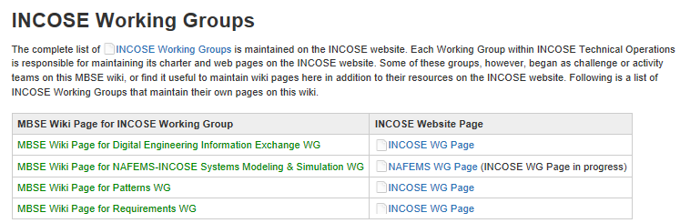
MBSE WIKI
http://www.omgwiki.org/MBSE/doku.php

Slide 18
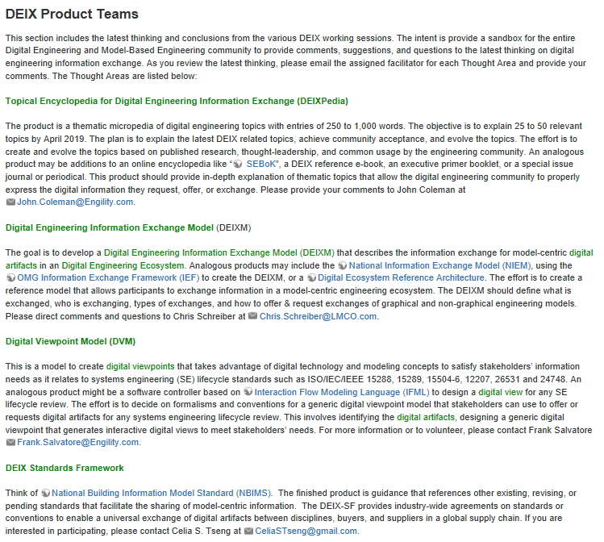
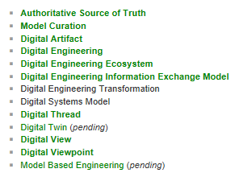
DEIXWG Product Teams
List of DEIX Topics for Development

Slide 19
Questions??

