Slide 1
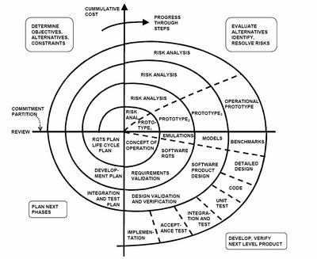
16 YEAR Engineering Education Plan :
Past , Present and Future
SPEAKER :
MARCOS CHU
Capella University.
Ph.D Student in Accounting
3-D Printing Technology
Boehm, 1988

Slide 2
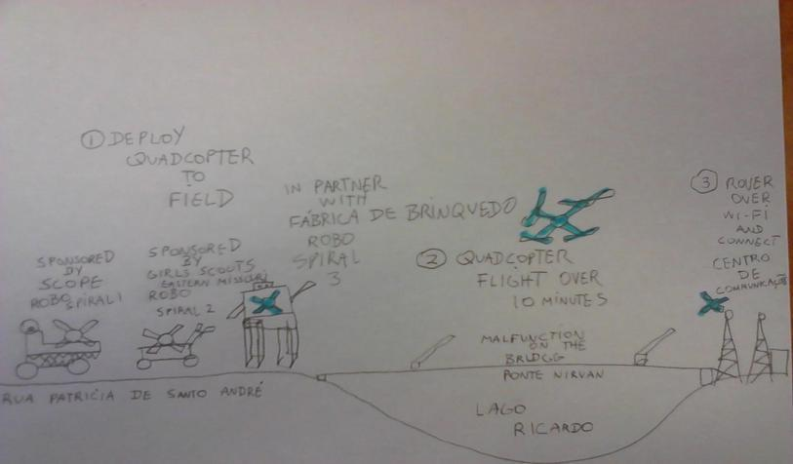
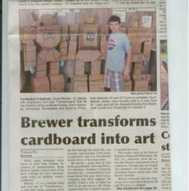
SPIRAL 1 MISSION
SPIRAL 3 ROBOT : GARDENING ROBOT
($6,000)
($12,000)
($5,000)
($10,000)
($8,000)
(NRE $4,000) (PROD $1,000)
(NRE $3,000) (PROD $1,000)
(NRE $2,000) (PROD $1,000)
(NRE $1,000) (PROD $1,000)
(PROD $600)
(NRE $500) (PROD $1,000)
SPIRAL 1 : RECYCLING CRUSHING ROBOT ($20,000)
SPIRAL 2 : RECYCLING SORTING ROBOT
SPIRAL 3 : URBAN FARMING ROBOT
SPIRAL 4 : URBAN FARMING UNDERWATER ROBOT
SPIRAL 5 : URBAN FARMING TRANSPORT ROBOT
SPIRAL 6 : URBAN FARMING HUMANOID ROBOT
SPIRAL 7 : URBAN FARMING AUTONOMOUS HUMANOID ROBOT
SPIRAL 8 : URBAN FARMING AUTONOMOUS MODULAR HUMANOID ROBOT
SPIRAL 9 : URBAN 5K RACER TRANSPORT ROBOT
SPIRAL 10 : URBAN 5K RACER HUMANOID ROBOT
SPIRAL 11 : URBAN 5K RACER AUTONOMOUS HUMANOID ROBOT
SPIRAL 12 : URBAN 5K RACER AUTONOMOUS MODULAR ROBOT

Slide 3
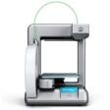
INCOSE MG Learning Communitties
00 | 01 | 02 | 03 | 04 | 05 | 06 | 07 | 08 | 09 | 10 | 11 | 12 | 13 | 14 | 15 | 16
$1,299
ORIGINAL CONCEPT : AUSTIN, TX
AUSTIN COMMUNITTY COLLEGE – JAVA PROJECT
Life Cycle Cost
REVISED: JAN 13 2010
2005
“3D printers start at $22,900 for the InVision LD lamination system from 3D Systems (manufactured by Solidimension) and climb to more than $100,000 for the Eden 330/333 from Objet Geometries”
ROBOTICS COACH
Robotics
Competition
Programs
2002
“These tools range in cost from $30,000 to $800,000
  >$100K are typically called rapid prototyping systems
  <$100K are usually called 3D Printers”
2000
“But ThermoJet -- with a U.S. list price of $49,995 for single units -- produces its output quickly and affordably in an office setting.”
Mentor Development

Slide 4
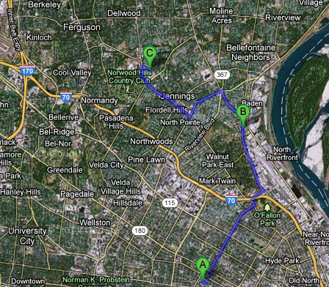
Your’s Market (Company)
STEM Corridor
4.4 Miles
Ranken ( Higher Education)
2016
STEAM CENTER

Slide 5

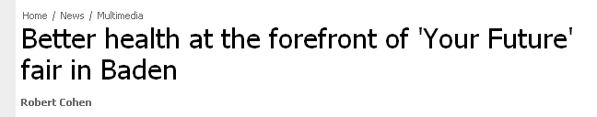
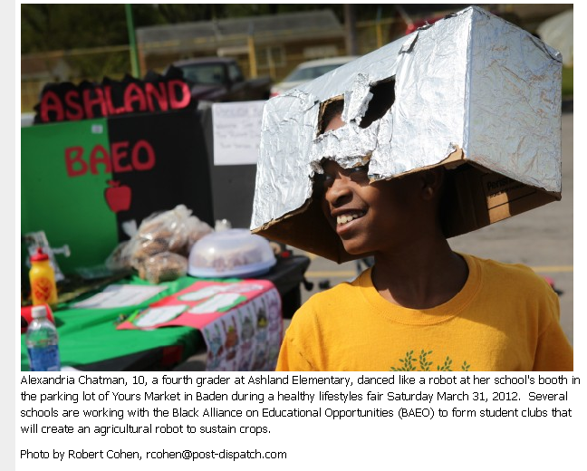
STEM Corridor
Your’s Market
(Company)
STEM Corridor
4.4 Miles
Ranken
( Higher Education)

Slide 6
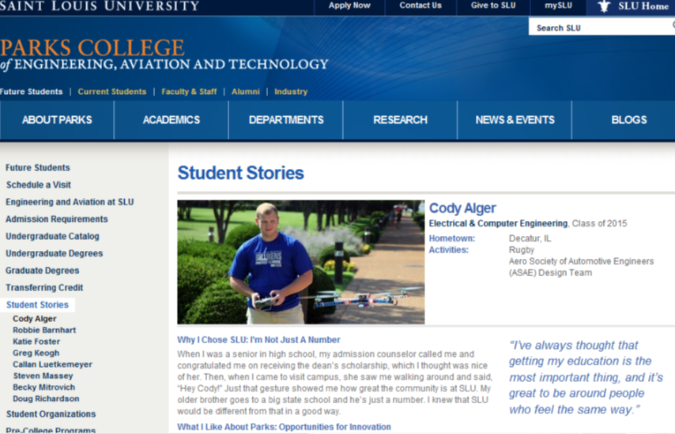
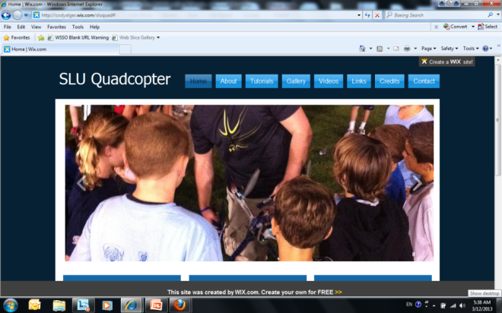
GLOCAL: ST. LOUIS UNIVERSITY
“ Well that is a fairly common question. Luckily I had an amazing professor for my Intro to Electrical and Computer Engineering here at SLU who instead of standing up in front of us talking about engineering the whole time, he would bring in guest speakers from businesses around Saint Louis to talk to us. One of them was Marcos Chu. Mr. Chu's topic that day was brain storming and how it is used in the workplace. As a challenge for the class to think about was how to mount electric motors to some pieces of PVC tubing. He told us that this was to build a quadcopter that a group was working called the Broad Engagement Robitic Spiral Demo Team (or BERSDT because that is really a mouthful). This immediately sparked my interest because I love anything that flies.”
Cody Alger

Slide 7
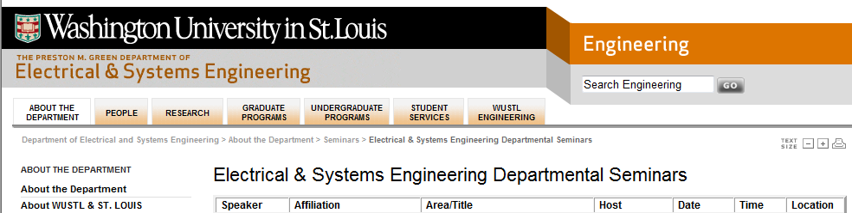
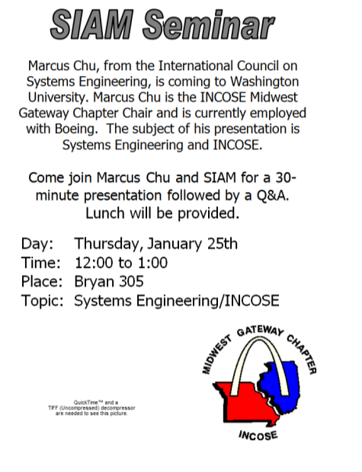
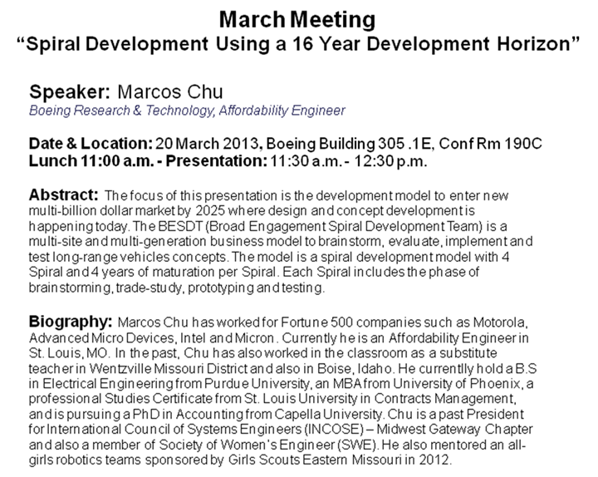
GLOCAL: WASHINGTON UNIVERSITY
2007
YEAR 0 : SYS ENG
2008
YEAR 1 :COMMUNITTIES
2009
2010
2011
2012
YEAR 2 : BEST ROBOTICS
YEAR 3 : PROCESS
YEAR 4 : E-WEEK
YEAR 5 : QUADCOPTER
2013
2007

Slide 8
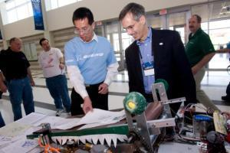
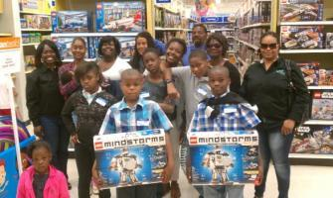
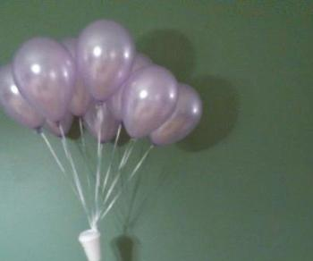
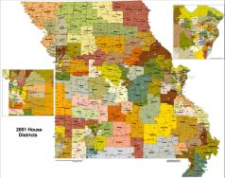
Dashboard
5K Run Quadcopter – 4 pound Class. (2000 – 2016)
0 | 1 | 2 | 3 | 4 | 5 | 6 | 7 | 8 | 9 | 10 | 11 | 12 | 13 | 14 | 15
LIFECYCLE COST DEV |  |  |  | BRAINSTORMING |  |  |  | PROTOTYPING |  |  |  | TESTING
SPIRAL 1 , 2, 3, 4, 5, 6, 7, 8, 9, 10 ,11, 12 TEAMS : 240 MEMBERS
MENTOR TRAINING ONLY – K12 OUTREACH DONE BY SEPARATE DEMO TEAM
Manned Quadcopter (Flying Car) – 4000 pound Class. (2016 – 2034)
0 | 1 | 2 | 3 | 4 | 5 | 6 | 7 | 8 | 9 | 10 | 12 | 13 | 14 | 15 | 16 | 17 | 18
LIFECYCLE COST |  |  |  | BRAINSTORMING |  |  |  | PROTOTYPING |  |  |  | TESTING |  |  |  | PROD

Slide 9
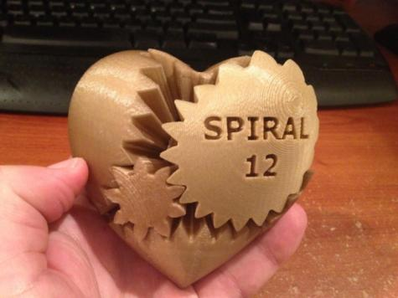
PROCESS
 | LEAD COMMUNITY | KEY DEMO
2000 | AUSTIN, TX | AUSTIN CC
2001 | PHOENIX, AZ | KYRENE ELEMENTARY
2002 | BOISE, ID | NAPA H.S
2003 | ST. LOUIS, MO | PARKWAY M.S
2004 | LOS ANGELES, CA | RIDGECREST MIDDLE
2005 | WENTZVILLE, MO | LAKE STL JAYCEES
2006 | URBAN CORE : FUTURE TREK
2007
2008 | MEMPHIS, TN | TENESSE UNIVERSITY
2009 | MARIETTA, GA | BEST ROBOTICS
2010 | ROANOKE, VA | VIRGINIA TECH
2011 | CHARLESTONE, SC | CITADEL
2012 | GLOBE, AZ | COPUS
BRAINSTORMING
First project : Spiral 1 – 2000
TRADE STUDY
First project : Spiral 4 - 2004
CHINA LAKE - California
PROTOTYPING
First project : Spiral 9 - 2009
Saratobia - Mississipi
TESTING
AUSTIN - Texas
Last project: Spiral 12 – 2012
St.Louis - Missouri
PROPOSAL SEED BASED FUNDING
GRANT BASED FUNDING
STAKEHOLDER BASED FUNDING
2014

Slide 10


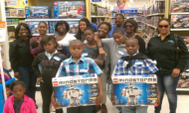
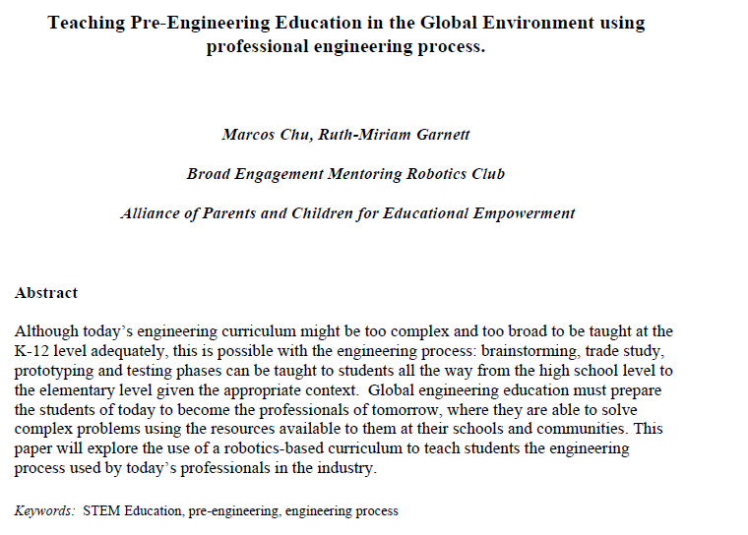
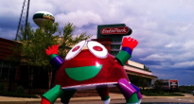
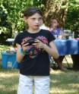
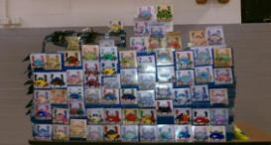

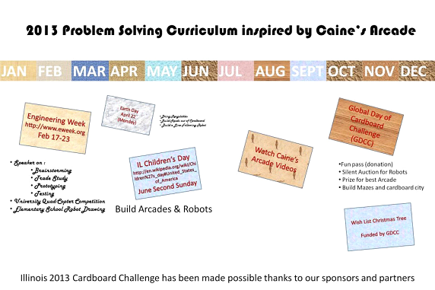
FRAMEWORK
HANDOUTS
4 STEP PROCESS
PEER REVIEWED PAPERS
ROBOTICS PROGRAM
@ St. Louis Public Schools:2012-2013,Langston, Colombia, Wallbridge
POWERPOINT
PRESENTATION
DURING E-WEEK
TO PROFESSIONAL
ORGANIZATIONS
ATTRIBUTES
Integrated Development
  Full pipeline K-20
  Industry Neutral
Grass Root with organizational structure
  BRC, BEMRC, BERSDT,BEMRIC……(12 structures)
Stakeholder Financing Model
  ROI tracked = (benefits / investment)
CALENDAR / SPONSOR

Slide 11
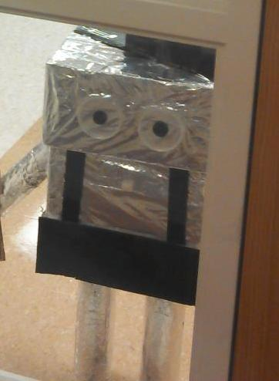
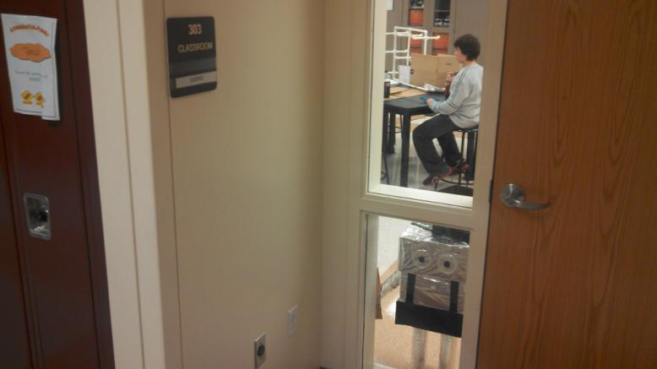
MENTOR TO STUDENT : PARENT ENGAGEMENT
ASME Sponsored Activity : Robot Arm
$300 to Hancock H.S – All Girls Robotics Team.
  Total proposal request $300.
  $100 – pizza subsidy at kickoff
  $100 – Materials to build one robot arm.
  $100 – pizza subsidy at demo event.
LC007
ROBOT READY FOR 4th July Parade

Slide 12
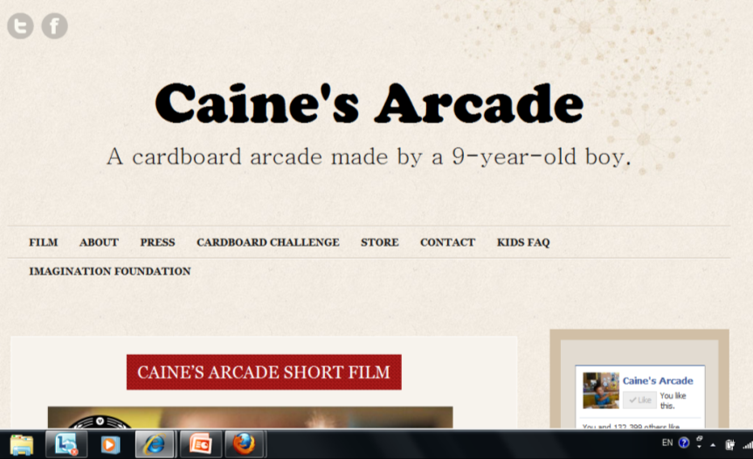
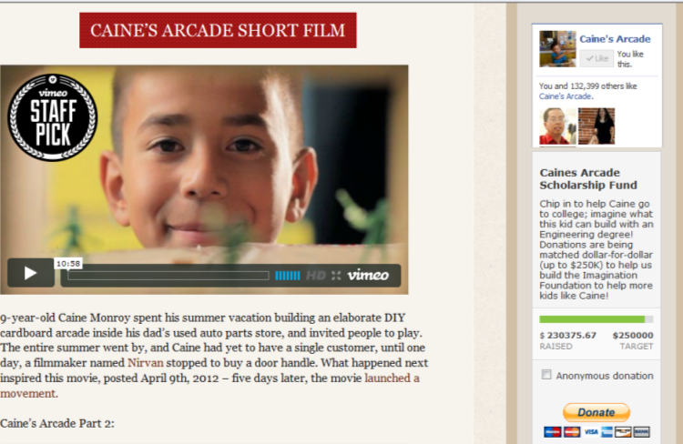
GLOCAL : CAINE’S ARCADE

Slide 13
Q& A
FOR MORE INFO :
Marcos Chu (Principal Researcher)
Facebook: Mark Chew Academy

