Slide 1
Chapter Business
Announcements?
Next month’s presentation
Ambassador Volunteers?
Volunteers to speak for 10 minutes about innovation at future meeting (Sep?)
Chapter working group (WG) volunteers?
Organize Fall Research & Technology Symposium
INCOSE Working Groups
Complex Systems WG
Involvement?
Complex systems principles and systems engineering

Slide 2
INCOSE Working Groups – A Way to Get More Involved
More than 40 Working Groups
Hold meetings at INCOSE events
Educational, networking, planning
Produce papers
Coordinate meeting panels
Collaborate to identify and develop working group products

Slide 3
Systems Science Working Group
2015
The SysSci WG Charter is
SysSci WG Chairs:
James Martin & Duane Hybertson
INCOSE Connect address:
WIKI Site: sites.google.com/site/syssciwg/
INCOSE Web page:
www.incose.org/practice/techactivities/wg/syssciwg/
Number of Members: 100+
Promote the advancement and understanding of Systems Science and its application to SE.
Objectives:
Encourage advancement of Systems Science principles and concepts as they apply to SE.
2) Promote awareness of Systems Science as a foundation for SE.
3) Highlight linkages between Systems Science theories and empirical practices of SE.
Published Products
Planned Work (current)
Systems Philosophy
Systems Science Literacy
Systems Processes Theory
System Pathologies Id & Characterization
Schemas Theory & Category Theory
Synergies Between SS, SE & EOS
SS for SE Education & Training
Ontology of a System
Periodic Table of Systems
Systems Praxis
Various workshop presentations and reports posted on our Systems Science Working Group wiki site
sites.google.com/site/syssciwg

Slide 4
Complex Systems Working Group
Goal: Enhance the ability of the systems engineering community to deal with complexity.
The WG “works at the intersection of complex systems sciences and systems engineering, focusing on systems beyond those for which traditional systems engineering approaches and methods were developed.”
Collaborates with the Systems Sciences, Natural Systems, and Agile SE Working Groups

Slide 5
Complex Systems Working Group
Work System Being Developed or Changed
System Development System
People,
Work Culture
People,
Work Culture
Ecosystem
Ecosystem
Technology
Methods
Practices
Artifacts
Technology

Slide 6
Complex Systems WG Topics
Tuesday, February 2, 2016 9:00 to 12:00 Noon, PST Web Address: https://incose.pgimeet.com/GlobalmeetTwelve (join as GUEST) Access Number: 1-719-457-1414/1-888-619-1583 Guest Passcode: 944 440 9838
9:00AM – 9:45AM: Introductions and overview of CxS WG (Jimmie McEver)
9:45AM – 10:45AM: Toward a Complex Systems Engineering Maturity Model (Brian White)
10:45AM – 11:30AM: Engineering Elegant Systems, Systems Engineering Research Consortium (Michael Watson)
11:30AM – 12:00PM: Identification of and organizing for prospective 2016 WG projects and products (McEver and Watson)

Slide 7
Complex Systems Working Group
Seeks to “better integrate and align the Working Group’s approaches for dealing with complexity with the range of systems engineering communities represented in INCOSE.”
Do we have interest as a Chapter?
Contribute to ongoing WG projects?
Propose new topics or projects?
Convene a chapter-level affiliate WG?

Slide 8
Using Complex Systems Principles to Anticipate Change Effects
Kelly Neville
INCOSE ~ Orlando Chapter
March 2016

Slide 9
Outline
Characteristics of Complex Systems
Examples
A Methodological Problem
Ideas for Addressing the Problem
That are compatible with the nature of complex systems
That focus on the preservation of a system’s resilience

Slide 10
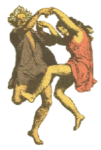
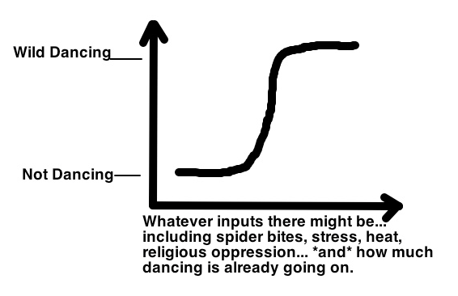
Complex Systems
Source: https://fcbrowncl0ud.wordpress.com/2015/08/13/on-witchcraft-and-mass-psychogenic-illness/

Slide 11
Complex Systems
Interconnected, interdependent elements
Diverse elements; Interactions produce increasing variety
Self-organize and adapt
Produce bottom-up phenomena – emergent structures and capabilities
Nonlinear behavior
Small changes can produce large events
Butterfly effect
Can withstand “large events” (are resilient)
Prone to tipping points
System behavior changes dramatically
Unpredictable, not entirely know-able

Slide 12
Examples of Ways We Change Our Complex Systems

Slide 13
Introducing Remotely Piloted Aircraft into the National Airspace System

Slide 14
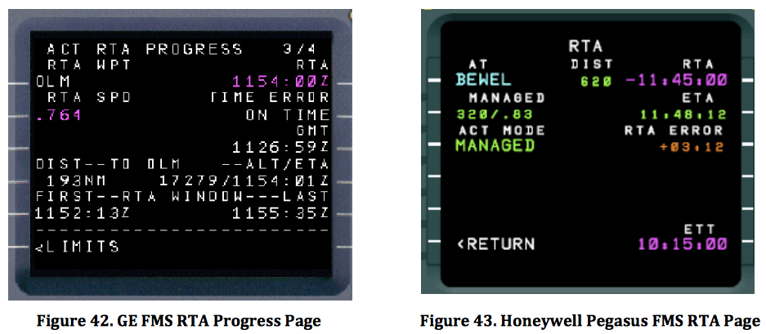
Introducing “Required Time of Arrival” into Flight Operations and Control

Slide 15
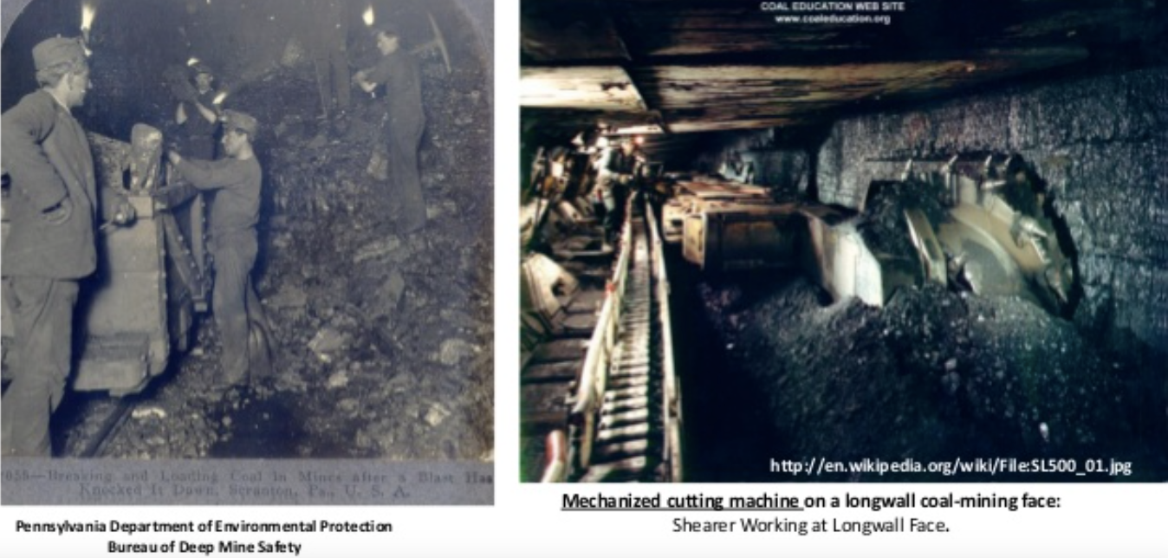
Introducing Machinery
into Longwall Coal Mining

Slide 16
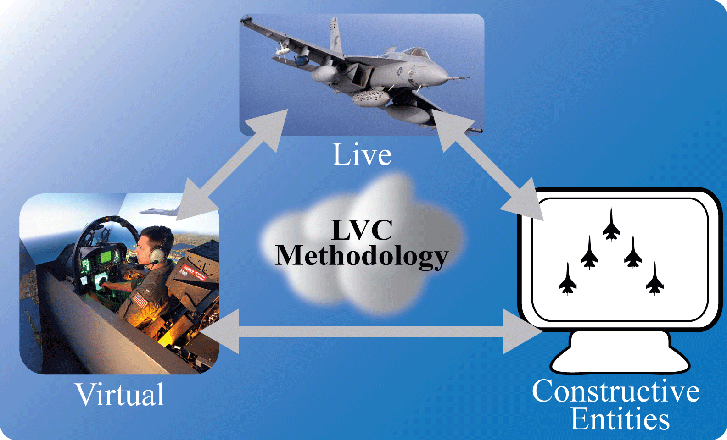
Introducing Computer-Generated Aircraft into Live Air Combat Training
Live – Real aircraft, real pilots
Virtual – Aircraft simulator, real pilots
Constructive – Computer-generated aircraft and pilots
Notes:
Intro

Slide 17
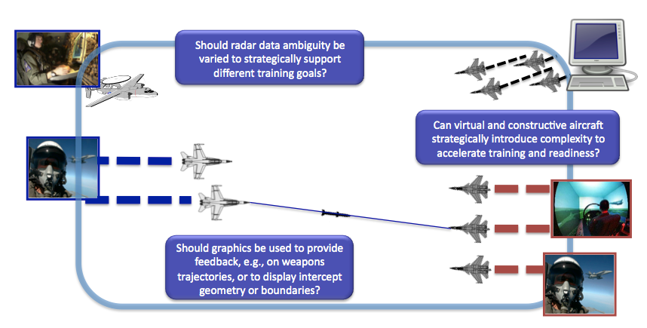
Emergence of New Possibilities

Slide 18
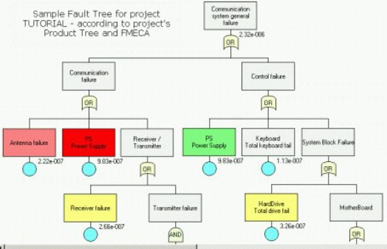
The Problem
It’s impossible to identify all the ways a change will impact a complex system.
Traditional system engineering methods for integrating the new and old are not adequate.
For example…
A failure modes and effects
analysis (FMEA), fault tree
analysis (FTA), etc. will only identify
a subset of what could go wrong.

Slide 19
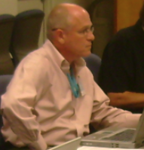
“The conclusion is pretty straightforward. Traditional systems engineering doesn’t lend itself to managing the engineering of AOCs (and by extension, enterprises).”
- Doug Norman & Michael Kuras
Norman, D.O. & Kuras, M.L. (2006). Engineering complex systems. In D. Braha, A.A. Minai, & Y. Bar-Yam (Eds.), Understanding complex systems (Ch 10). Heidelberg, GE: SpringerLink.

Slide 20
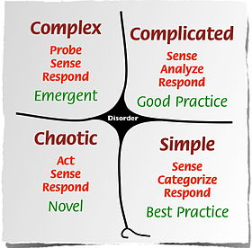
Dave Snowden’s Cynefin Framework
http://cognitive-edge.com/resources/videos/

Slide 21
Solutions =?
Use existing systems engineering methods and tools that can accommodate
Change and emergence
Relationships, interactions, and synergies
Permeable boundaries
Uncertainty and imprecision
or
Use new methods, e.g., that are derived from complex systems principles
or
????

Slide 22
Some Ideas Sillitto, 2010
Maintain system stability while achieving useful emergent behavior
Understand how micro-actions influence macro-behavior
Naturalistic research to understand system
Identify and monitor the system’s Stability Margin
Real-time health indicators=?
System’s selective pressures =?
Avoid drift
Ex: Petrochemical Process Control

Slide 23
Some Ideas Sillitto, 2010
Feedback for Protection
From deliberate threats
Optimization and connectivity as sources of vulnerability
Co-opting for ill intents
Cybertheft, hijacking
Shift focus from risk management to opportunity management
Systems get their value from the purposes they serve.
Model system architectures as interacting layers of webs with social and technical connections

Slide 24
Complex Systems Principles
Offer a Means
to Tie Together
the Social and Technical,
Micro and Macro

Slide 25
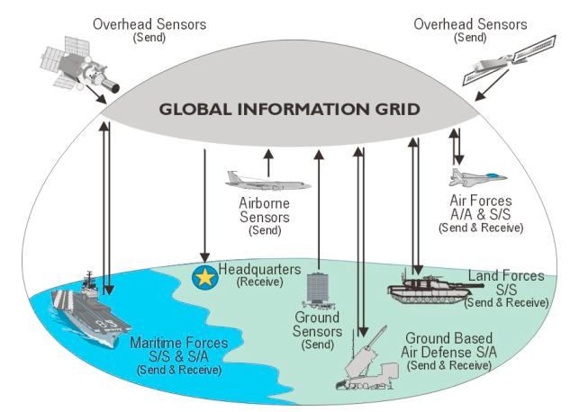
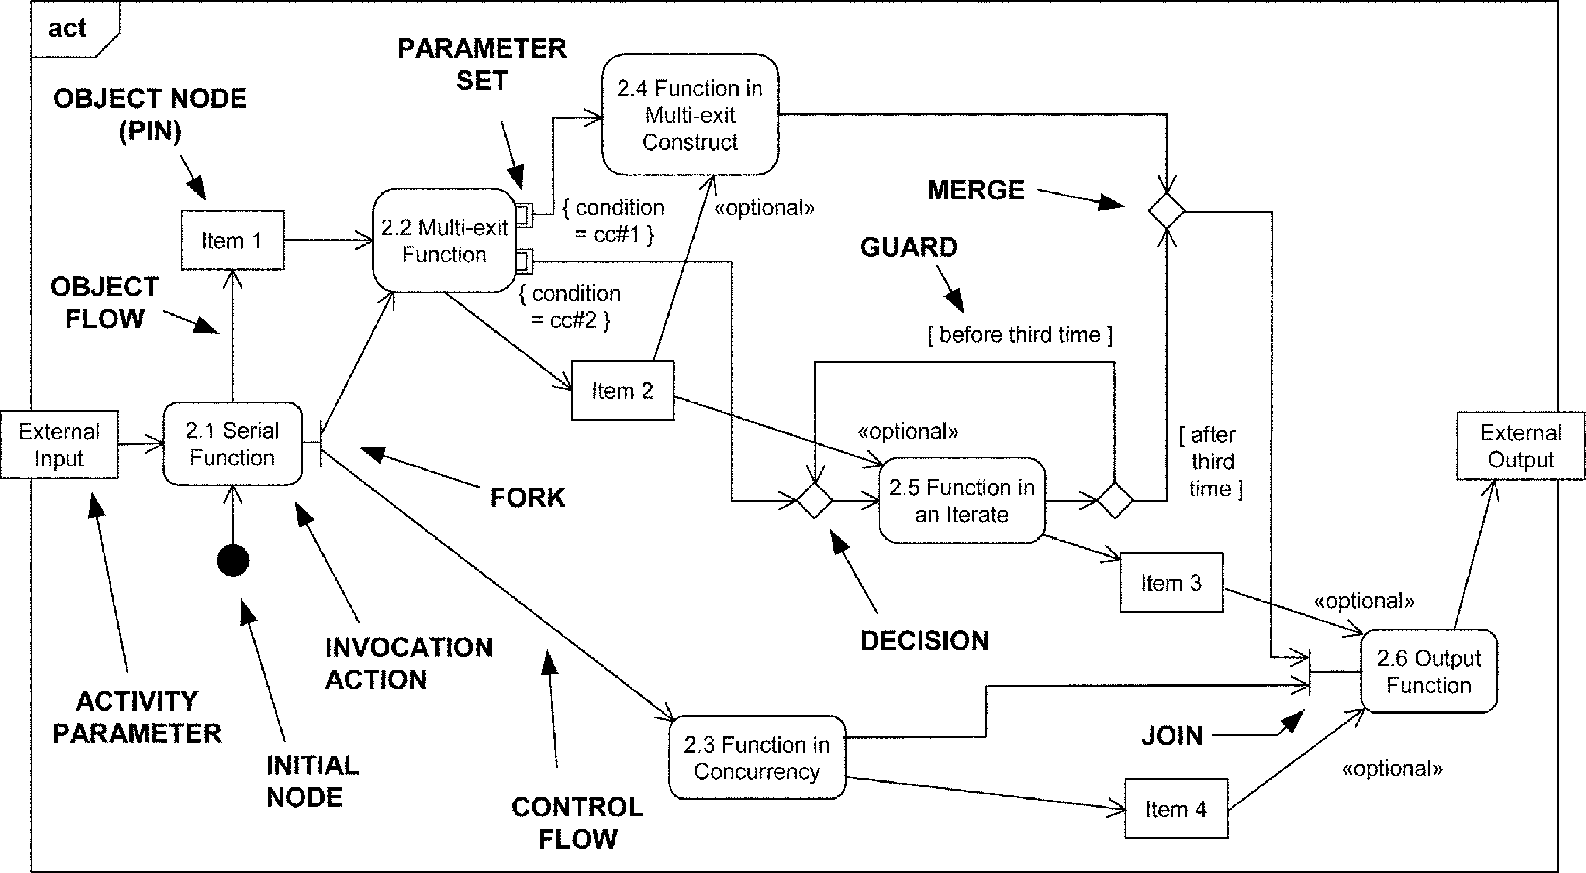
Core Sources of System Stability and Resilience
X
X
X
X
X
X
X
Design specs need to be tied to system purpose and sources of system resilience.

Slide 26
Five Sources of Tension
Complex systems tend to thrive on the right side of the scales.
What matters is whether a change disrupts the system’s balance on any of these continua.
Follow Plans
Flexibility
Optimized/Specialized
Generic/Adaptive
Centralized
Decentralized
Short-Term Focus
Long-Term Focus
Single Knowable Perspective
Multiple Perspectives

Slide 27
Disruptions in the balance of those core system states could impact a system’s ability to:
Respond resiliently to the demands to which it had adapted.
Achieve its objectives
Maintain its health
Protect itself and its elements from damage and injury

Slide 28
Five Sources of Tension Example: Live Air Combat Training
Follow Plans
Flexibility
Constructive aircraft are dynamic
Constructive aircraft follow scripts
Optimized/Specialized
Generic/Adaptive
Multiple rule sets to choose from
Encoded rules only allow live aircraft to merge
Centralized
Decentralized
Decision making is decentralized; New roles, greater complexity increase it
Range Training Officer (RTO) monitors and oversees exercises

Slide 29
Five Sources of Tension
Short-Term Focus
Long-Term Focus
Need for computer-generated friendlies might emerge
No need for computer generated friendlies
Single Knowable Perspective
Multiple Perspectives
Adversary pilots help RTO monitor for safety issues
Computerized adversary pilots don’t recognize safety issues

Slide 30
Next, Consider a Broader Set of Complex Systems Principles – of Ways Complex Systems Adapt & Maintain Resilience

Slide 31
Sources of System Resilience and Tension
Selective Pressures
Obvious, Visible
Subtle, Obscured
Entropy, Interactions, Emergence
High Potential
Low Potential
Positive Attractors
Encouraged
Discouraged
(New useful patterns of action)
Shared & over-
lapping functions, multiple perspectives
Functional Redundancy
Solo decision making, independent functions, twin backups
Flexible,
Adaptive, Evolvable, Generic
Rigid,
Fixed Plans, Specialized, Optimized
Support for Local Control
Sound,
Robust
Tactical Control Loops
Lags,
Gaps
Local Decentralized Control with Distant Supervision
Distant Centralized
Control with Local Execution
Sound,
Robust
Tactical Feedforward Loops
Lags,
Gaps
Support for Distant Supervision
Lack of Learning Mechanisms
Organizational Learning
Strategic Control Loops

Slide 32
A House of Quality?

Slide 33
Core Sources of System Stability and Resilience
X
X
X
X
X
X
X
Design specs need to be tied to system purpose and sources of system resilience.

Slide 34
Challenges
Qualitative Research
What could go wrong?
What prevents those things from happening?
How to Recognize Sources of Resilience in the System
Artifact Design
How to Justify Taking Action
How does this change the Systems Engineering Process?

Slide 35
Questions? Ideas?

Slide 36
References
Bar-Yam, Y. (2004). Making things work. Boston, MA: NECSI Knowledge Press.
Hoffman, R.R., & Woods, D.D. (2011). Beyond Simon’s slice: Five fundamental trade-offs that bound the performance of macrocognitive systems. IEEE Intelligent Systems, Nov/Dec, 67-71.
Kitano, H. (2004). Biological robustness. Nature Review Genetics, 5, 826-837.
Paries, J. (2006). Complexity, emergency, resilience. In E. Hollnagel, D.D. Woods, & N. Leveson (Eds.), Resilience engineering: Concepts and precepts (pp. 43-53). Burlington, VT: Ashgate.
Pflantz, M.A., & Levis, A.H. (2015). On evaluating resilience in C3 systems. Insight, 18(1), 29-33.
Snowden, D. J., & Boone, M. E. (2007). A leader's framework for decision making. Harvard Business Review, 85(11), 68-75.
Woods, D.D., & Branlat, M. (2010). Hollnagel’s test: Being in ‘control’ of highly interdependent multi-layered networked systems. Cognition, Technology, and Work, 12, 95-101.

Slide 37
What preservation mechanisms have developed within the system?
These help keep the system healthy in the face of disruption & give the system resilience.
Are any of those mechanisms compromised by the changes?
Are there any impacts of the change that the mechanisms cannot protect against?

Slide 38
Example BRASS Queries
Is the system’s health compromised by the change?
Identify the system’s sources of resilience. Interview domain experts to identify:
Possible negative consequences
How the system protects itself
Use interview data to judge whether resilience is affected:
Are any possible consequences not mitigated by the resilience sources?
Are any resilience sources compromised?
Revisit and address items with median or negotiated ratings above a threshold.

Slide 39
Next Steps
Further research on the feasibility of BRASS for assessing current systems and supporting acquisition decision making
Assess relevant decision support and usability requirements of acquisition decision makers
Test within existing system change initiatives
Does it add value?
Continue iterative development process
Currently in the early stages of development

Slide 40
Example Query
Distant Supervision vs Local Control: Does the change impair or slow the operator's ability to choose, in real time, responses that are in tune with and responsive to unfolding situations?
Yes: Constructive pilots, if pre-programmed according to Standard Operating Procedures (SOPs) and the mission plan, reduce operator (live pilot) control over the mission’s execution.
Could jeopardize the system’s learning objective
Could compromise pilot safety

Slide 41
Example Query Cont.
Yes: Constructive pilots, if pre-programmed according to Standard Operating Procedures (SOPs) and the mission plan, reduce operator (live pilot) control over the mission’s execution.
Could jeopardize the system’s learning objective
Could compromise pilot safety:
A pilot could be distracted by the work of getting constructive pilots to keep up and adapt.
A pilot could think an aircraft will turn away or stop painting his wingman, but the aircraft—a constructive—is too slow to recognize and respond to the situation. The pilot panics and makes a sudden last-minute maneuver.
Possible mitigation: Humans control 1 to 3 constructive entities to optimize their responsiveness.

Slide 42
Example BRASS Queries
Selective Pressures are Salient | Does the change interfere with any system element's ability to detect, perceive, or interpret critical cues? | N/A
Entropy & Variety | Does the change reduce interactions or other opportunities for new and improved ways of doing things to emerge? | Follow Plans vs. Flexibility
Functional Redundancy- Detection | Does the change reduce the number of system mechanisms (strategies, resources, tools…) that contribute to detecting concerns/threats? | Single vs Multiple Per-spectives
Functional Redundancy- Avoidance | Does the change reduce the number of mechanisms that contribute to averting concerns/threats to the system or its objectives? | Specialized vs Generic
Distant Supervision vs Local Control | Does the change impair or slow the operator's ability to choose, in real time, responses that are in tune with and responsive to unfolding situations? | Single vs Multiple Per-spectives
 | Does the change impair or slow the operator's ability to accurately use procedures, guidelines, and goals defined by a higher organizational level? | Centralized vs Decentralized

Slide 43
Next, Consider a Broader Set of Complex Systems Principles – of Ways Complex Systems Adapt & Maintain Resilience
Looseness in the system – Entropy, Diversity, Flexibility, Loose couplings
Interactions producing Emergence
Functional redundancy
Polycentric control
Bi-stability
Anticipation, Feedforward loop
Visibility of approaching thresholds and selective pressures
Co-evolution, Co-adaptation
Feedback
Self-organization

