Slide 1
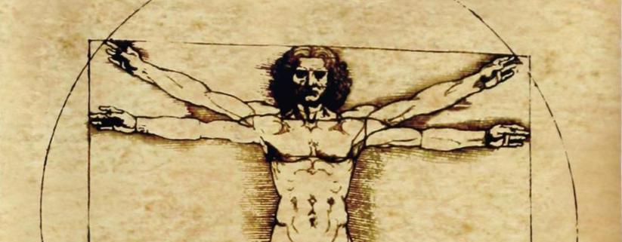
Trajectory Recovery System (TRS)
INCOSE Meeting 05.19.2016
Nicholas Kasdaglis Ph.D Candidate, HCDi
Tiziano Bernard
Graduate Student, MAE
Benjamin Remy
Graduate Student, HCDi
Lucas Stephane
Assistant Professor, HCDi
Alexander Troshcheko
Undergraduate Student, CS
School of Human Centered Design, Innovation & Art: Trajectory Recovery System

Slide 2
Agenda
Work to Date
Algorithm
Integration
Evaluation
Results to Date
Time Line
School of Human Centered Design, Innovation & Art: Trajectory Recovery System

Slide 3
Summary of Work: TRS and HCD Solution
Video can be viewed at this link:
https://youtu.be/pehiyWh2itM?list=PLNapSN-_5IKHDvsE30GRiB_5JvGKiIs-B

Slide 4
Iterative Design

Slide 5
Project Milestones
TRS Test Scenario Development
Algorithm Development and Formalization
Software Integration into Simulator
Test Protocol Development with IRB Approval
Prototype 4.x Testing
School of Human Centered Design, Innovation & Art: Trajectory Recovery System

Slide 6
TRS Test Scenario Development
Method
Description
Goals: Scenarios to ensure:
Accurate, appropriate, and realistic scenarios based upon real operational situations
TRS testing protocol incorporates appropriate controls and measures, for 4.x integrated evaluation.
Identify and develop three prototypical scenarios
Testing and refinement of scenario in 737 simulator
Eliciting Data Mapping Requirements
Mapping of flight parameters to aerodynamic flight profiles and to candidate crew behaviors.->Algorithm Development
Knowledge Elicitation of Experts:
4 Active Professional Pilots
Critical Decision Method
Synthesis: Eliciting Thematic Scenario Primitives
Card Sorting Task
Brainstorming
Result
Three Scenarios
Nose High (Accelerated Stall)
Unusual Attitude
Nose Low (Gradual)
School of Human Centered Design, Innovation & Art: Trajectory Recovery System

Slide 7
Algorithm Development and Formalization
Target Engagement and Disengagement
TRS is animated by an aerodynamic algorithm. Exceeding critical angle of attack and slowing down to below stall speed are considered as the triggering elements, as shown in equation
Another criterion that engages the TRS is the airspeed dropping below the stall speed. The second criterion is shown in equation 2.
Providing two independent triggering points for TRS increases safety by assuring more aspects of the incipient stall are acknowledged by the system. Disengagement criteria are defined by the triggering airspeed, a safe angle of attack (8º), and a safe vertical speed (100 feet per minute) demonstrating a gain in altitude. Initial testing demonstrated that these values were excellent and provided a successful recovery.
School of Human Centered Design, Innovation & Art: Trajectory Recovery System

Slide 8
Algorithm Development and Formalization
Target will present itself at the point where the aircraft would experience zero angle of attack. This angle will constantly move, as the pitch attitude will decrease with the angle of attack shown.
The pitch attitude that the target displays on TRS, as shown in Equation 3, calculates the flight path angle of the aircraft. In order for the target to start increasing in pitch, a triggering airspeed has been decided to act as a criterion. The value for V2, (1.2Vs) was determined to be appropriate. If the triggering velocity as well as the flight path angle criteria are achieved, TRS target begins its ascent.
Bank-leveling guidance. A mirror equation was used to obtain the shifting of the target horizontally .
School of Human Centered Design, Innovation & Art: Trajectory Recovery System

Slide 9
Algorithm Development and Formalization
Iterative Development: Expert Feedback
Observations 1: Although our algorithmic approach allows the aircraft to recover, the angle of attack is much slower to decrease compared to the pitch attitude of the aircraft, causing the aircraft to accelerate to very high values.
Solution: A constant, or buffer, was therefore applied to the equation governing the location of the TRS target .
Observation 2: The trigger airspeed for recovery to account for “round-out maneuver”.
Solution: Just like the TRS target pitch position, a buffer was put in place to allow for a more rapid recovery, given the fact that the target will begin to increase in pitch as the airplane reaches its position.
Observation 3: Rate of ascent was not sufficient.
Solution: The last thoroughly tested value is the rate of ascent, which was decided to be 7 degrees per second. This was determined to be an aggressive enough pull up to allow a small loss in altitude.
School of Human Centered Design, Innovation & Art: Trajectory Recovery System
Notes:
Computationally derived ; empirically validated and optimized

Slide 10
Software Integration in the Simulator
Resources Required
Description
Requirements
The goal in this stage was to integrate TRS 4.x DLL plugin into simulator test bed.
This stage built upon the Algorithm Development and Formalization and the Prototype 4.x Usability Study stages.
Call and transmission of data stream for required algorithm flight parameters from simulator flight data
Graphic generation of TRS and requisite behaviors on Pilot’s PFD
Animated and context sensitive TRS
Software Engineer
GL Studio Support/C++
ESP Support
Team Effort
School of Human Centered Design, Innovation & Art: Trajectory Recovery System

Slide 11
Interdisciplinary Effort
Human Centered Design
Team
Aeronautical Engineer
Software Engineer
Human Factors Engineer
School of Human Centered Design, Innovation & Art: Trajectory Recovery System

Slide 12
Test Protocol Development with IRB Approval
Description
Task
Submission of IRB to FIT review board for test on human subjects. Thus documentation experimental design, test procedures and analytical methods and measures to be employed will be formalized .
Writing of Experimental Design
Methods
Writing of Protocol
Measures
And Analysis
School of Human Centered Design, Innovation & Art: Trajectory Recovery System

Slide 13
Apparatus

Slide 14
Cameras
Side
Top

Slide 15
Data Stream
Data Stream of Aerodynamic Parameters
IP Data Stream Synchronized with Video and Eye Tracking

Slide 16
Eye Tracking Ergoneers

Slide 17
Eye Tracking Ergoneers

Slide 18
Apparatus Video
https://youtu.be/VqdlKOMi93M?list=PLNapSN-_5IKHDvsE30GRiB_5JvGKiIs-B

Slide 19
EVALUATION Method

Slide 20
TRS Testing
Description
Study Design
20 pilots
2 hours
6 Scenarios
2 x 3 factorial within subject design
With TRS and Without TRS
Nose-low; Unusual attitude; and Accelerated stalls
School of Human Centered Design, Innovation & Art: Trajectory Recovery System

Slide 21
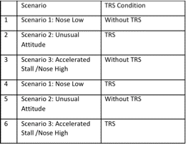
TRS Testing
Order Effects
Scenario Types
Participants placed in 1 of 6 groups
William’s (Latin) Square arrangement of scenarios
A 1 2 6 3 5 4
B 2 3 1 4 6 5
C 3 4 2 5 1 6
D 4 5 3 6 2 1
E 5 6 4 1 3 2
F 6 1 5 2 4 3
School of Human Centered Design, Innovation & Art: Trajectory Recovery System

Slide 22
TRS Testing
Subjective
Probes
Workload: NASA TLX (each scenario)
Situation Awareness ( Unusual Attitudes) : SART
Usability: SUS (end of each scenario type)
System State Awareness (end of each scenario type)
Objective
Ocular Measurements
Fixations
AOI
Saccades
Behavioral Patterns
Pupil Diameter
Interactions
Probes
Verbal protocol
Questions
Observations
Adjustments
Aircraft Performance
Time to VVI (vertical velocity indicator) reversal
Time AoA < 13
Average AoA
Net altitude loss
School of Human Centered Design, Innovation & Art: Trajectory Recovery System

Slide 23
Recovery Activity Without TRS
https://youtu.be/-pdFx6ZzK9Q?list=PLNapSN-_5IKHDvsE30GRiB_5JvGKiIs-B

Slide 24
Recovery Activity With TRS
https://youtu.be/qRwwFvWYHRY?list=PLNapSN-_5IKHDvsE30GRiB_5JvGKiIs-B

Slide 25
Analysis

Slide 26
Performance
Mark at “recover”
Net altitude loss
Airspeed variability
AOA variability
Time in secondary stall
Events in secondary stall
Inappropriate movement
Failure to make appropriate movement

Slide 27
Interactions
Strategies
Changing TRS rate
Pitch Boundaries
Behaviors
CFA

Slide 28
Interactions > Adjustments > Discovery
Slow down the upward target movement
Pilot didn’t trust TRS since it was going too fast

Slide 29
TRS and Subjective Workload
A repeated measures ANOVA was conducted to compare the effect of the display of TRS on workload as measured by NASA TLX (weighted rating). Results showed that TRS significantly resulted in lower reported workload F(1,19)=8.03, p=.011 across all three scenario levels. The effect size was calculated as partial eta squared .297

Slide 30
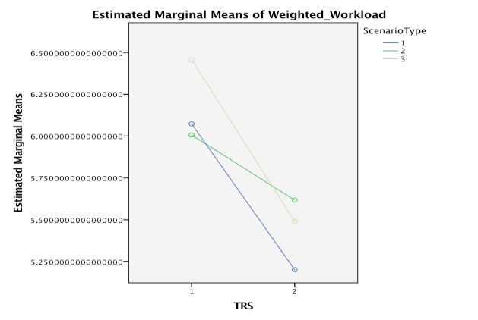
Workload
1 Nose low
2 Unusual Attitude
3 Nose high
Without
With

Slide 31
Flight Hours * TRS
1. 0 - 2000
2. 2000 - 5000
3. 5000 – 10.000
4. > 10.000
Without
With

Slide 32
Flight Employment
1. Capt
2. FO
3. Private
4. CFI
Without
With

Slide 33
Situation Awareness
Removed Vertical Speed
Removed Altitude
Removed Air Speed
=> Transfer to automation
Without
With

Slide 34
Situation Awareness Sub-components
Increase Understanding
Decreasing Demand

Slide 35
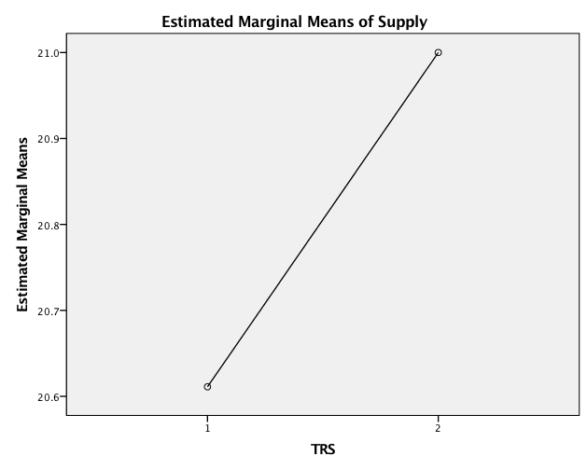
Supply of Information and TRS
TRS = Qualitative Information
Without
With

Slide 36
Situation Demand
Without
With

Slide 37
Understanding
Without
With

Slide 38
Usability

Slide 39
Usability
TRS > 90
SUS Threshold = 86

Slide 40
Papers (in press)
Kasdaglis, N., Bernard, T. (2016) Trajectory Recovery System: Angle of attack guidance for inflight loss of control. The Proceedings of Human Computer Interaction International, Lecture notes of Computer Science and Lecture Notes in Artificial Intelligence (In press)
Kasdaglis, N., Bernard, T., Stephane, L. (2016) Affordant Guidance for In-Flight Loss of Control: The Trajectory Recovery System. The proceedings of HCI-Aero 2016 (in press)
Kasdaglis, N., Stowers, K. (2016) Human centered design: bridging the gap between human factors and system engineering. The Proceedings of Human Computer Interaction International, Communications in Computer and Information Science (In press)

Slide 41
Questions?
Entire video playlist: https://www.youtube.com/playlist?list=PLNapSN-_5IKHDvsE30GRiB_5JvGKiIs-B
School of Human Centered Design, Innovation & Art: Trajectory Recovery System

