Slide 1
Common Core State Standards and Assessments of Student Mastery

Slide 2
Common Core Standards with goals of STEM in Florida
Common Core Reading Standards for Literacy in History/Social Studies and Technical Subjects
“Synthesize information from a range of sources (e.g., texts, experiments, simulations) into a coherent understanding of a process, phenomenon, or concept, resolving conflicting information when possible.”

Slide 3
Common Core State Standards
What are the content areas?
English language arts
Mathematics
Literacy standards
What student grades?
Kindergarten through 12th grade.

Slide 4
Emphasis in Addition to Content
English language arts:
Reading
Writing
Speaking
Listening
Language
Students who are College and Career Ready in English language arts:
Demonstrate independence
Build strong content knowledge
Respond to the varying demands of the audience, task, purpose, and discipline
Comprehend as well as critique
Value evidence
Use technology and digital media strategically and capably
Understand other perspectives and cultures

Slide 5
Emphasis in Addition to Content
Mathematical Practices, Students:
Make sense of problems and persevere in solving them
Reason abstractly and quantitatively
Construct viable arguments and critique the reasoning of others
Model with mathematics
Use appropriate tools strategically
Attend to precision
Look for and make use of structure
Look for and express regularity in repeated reasoning

Slide 6
Common Core Content Emphasis
English language arts standards emphasize:
Reading more complex narrative and informational text
Writing, speaking, listening and communicating using more complex language correctly.
Literacy in science, social studies and technical subjects; expecting comprehension of informational text in these areas.
Mathematics standards emphasize:
Fluent use of algorithms and properties
Conceptual understanding of algorithms and properties
The ability to use algorithms and properties to problem solve at high levels as evidenced by being able to build models of mathematical problems and communicate a defense of their solutions.

Slide 7
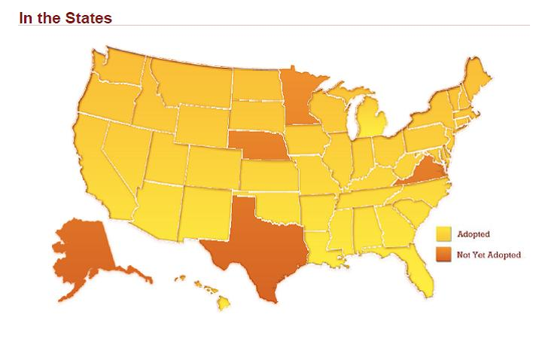
Common Core States in Yellow

Slide 8
Is there an International perspective?
While Common Core represents an improvement for Florida, in your opinion how does Common Core (US Standard) compare internationally.
Is there evidence from other states that students are more successful in college once having gone through Common Core improvements? i.e. is there a Benefit metric for this substantive undertaking?
Does Common Core have a positive or negative impact on “home schooling” or “virtual student learning”?

Slide 9
Florida’s Common Core State Standards Implementation Timeline
Year/Grade Level | K | 1 | 2 | 3-8 | 9-12
2011-2012 | F L | L | L | L | L
2012-2013 | F L | F L | L | L | L
2013-2014 CCSS fully implemented | F L | F L | F L | B L | B L
2014-2015 CCSS fully implemented and assessed | F L | F L | F L | F L | F L
F - full implementation of CCSS for all content areas
L - full implementation of content area literacy standards including: (1) text complexity, quality and range in all grades (K-12), and (2) CCSS Literacy Standards in History/Social Studies, Science, and Technical Subjects (6-12)
B - blended instruction of CCSS with Next Generation Sunshine State Standards (NGSSS); last year of NGSSS assessed on FCAT 2.0

Slide 10
Common Core State Standards Race to the Top Projects
Common Core State Standards Instructional Tool for Teachers
Student Tutorial
K-8 English/Language Arts Formative Assessment
K-8, Algebra and Geometry Mathematics Formative Assessment
ELA Interim Assessment (FAIR)
Textbook Demand Study
Common Core Standards Professional Development Developed and Implemented by Postsecondary

Slide 11
Professional Development
For the 65 school districts participating in Race to the Top and receiving a portion of the $350,000,000 based on Title I FTE, each had to:
Ensure that professional development programs in all schools focus on the new common core state standards,
Implement professional development programs at all schools that focus on the common core state standards,
Provide research-based professional development in the form of lesson study, providing teachers time to plan and improve instruction together.
Notes:
The professional development shall Include assisting students with learning challenges to meet those standards (such as through accommodations and assistive technology).
Implementation should include assisting students with learning challenges to meet the standards.

Slide 12
Professional Development
The Florida Department of Education has been providing professional development to teams from schools and districts based on the recommended Common Core State Standards Implementation Plan.
Implement the literacy standards in all grades and core content areas.
Fully implement English language arts and mathematics standards in kindergarten in 2011-12, first grade 2012-13, all grades 2013-14).

Slide 13
A New Assessment for Common Core
Partnership for Assessment of Readiness for College and Careers (PARCC)
Development is funded by federal funds
Florida will implement in 2014-2015 and these assessments will replace FCAT 2.0 assessments in reading, writing and mathematics

Slide 14
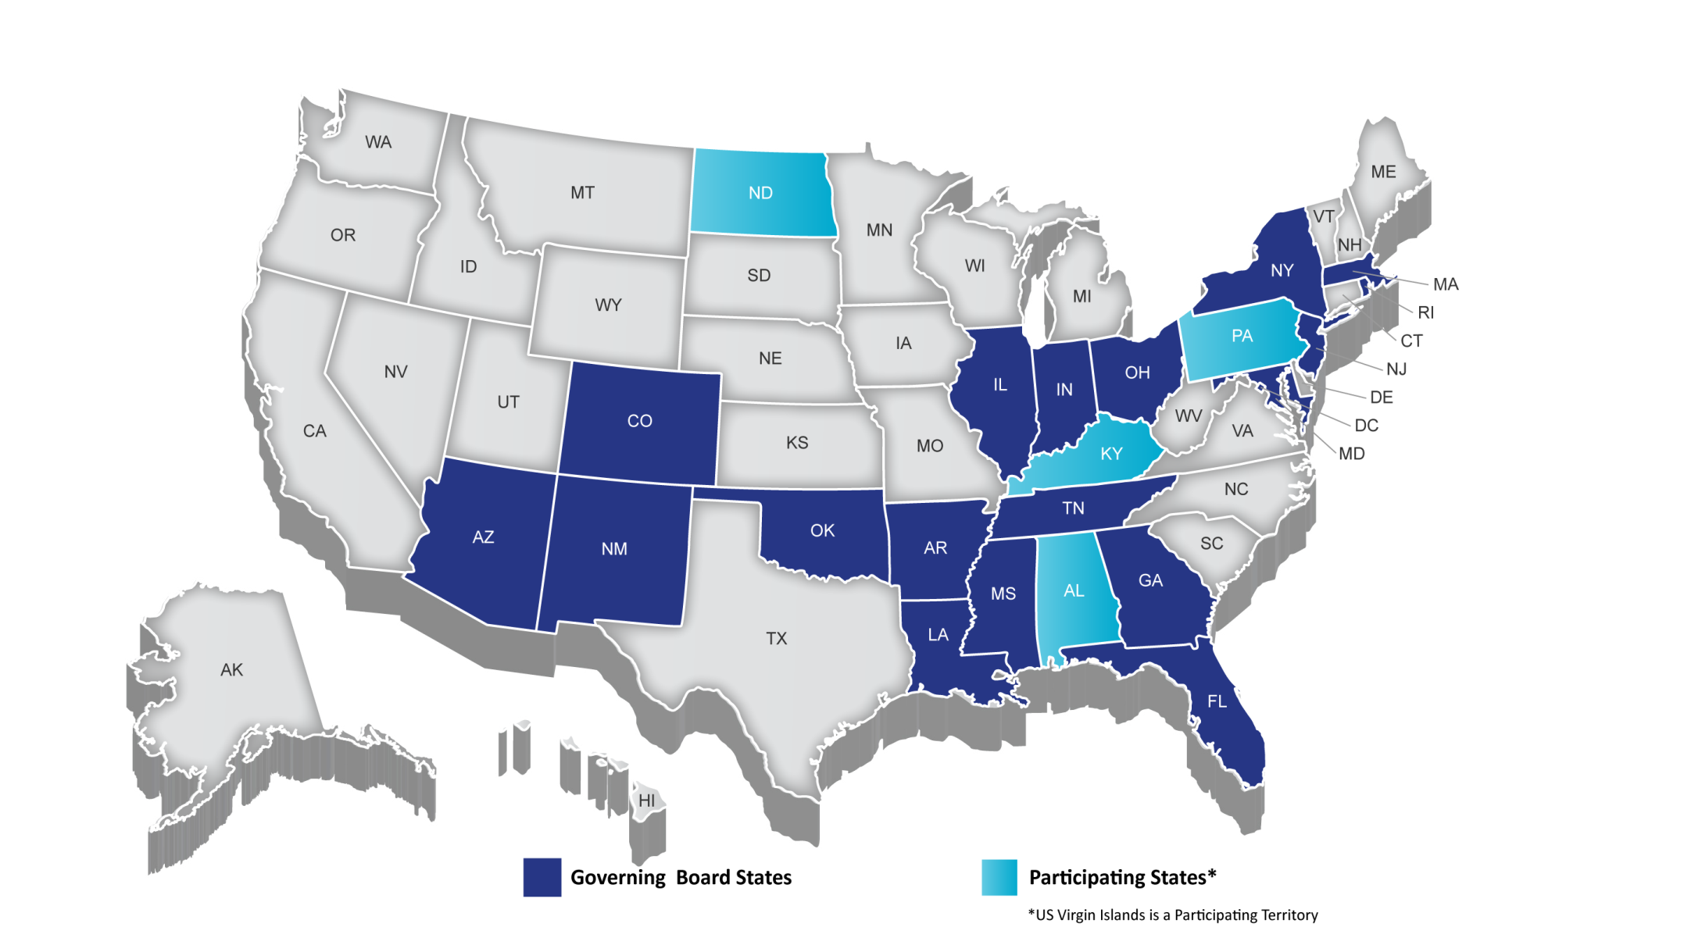
PARCC Membership
14
Notes:
TALKING POINTS
PARCC is an alliance of 23states, educating nearly 25 million students, that are working together to develop a common set of K-12 assessments in English and math anchored in what it takes to be ready for college and careers. PARCC is led by 19 governing board states (and D.C.) represented in Dark Blue.
CLICK: Achieve is the project manager for PARCC, essentially serving as the staff for the consortium and coordinating the work. Collectively the PARCC states educate nearly 25 million students.
Governing States will pilot and field test the assessment system components over the next three years and administer the new assessment system during the 2014-15 school year. Governing States will use the results from the PARCC assessments in their state accountability systems
The chief state school officers of the Governing States serve on the PARCC Governing Board and make decisions on behalf of the Partnership on major policies and operational procedures
Participating States (light blue) provide staff to serve on PARCC’s design committees, working groups, and other task forces established by the Governing Board to conduct the work necessary to design and develop PARCC’s proposed assessment system. By 2014–15, any state that remains in PARCC must commit to statewide implementation and administration of the Partnership’s assessment system Any PARCC Participating State prepared to make the commitments and take on the responsibilities of a Governing State can become one
NOTES
Governing Board: Comprised of K-12 chiefs from Governing Board States
Technical Advisory Committee: Comprised of state/national assessment experts
Leadership Team: Comprised of delegates of K-12 chiefs from Governing Board States (e.g., Assoc. Supt for Curriculum, Assessment and/or Instruction)
ACCR: Comprised of national and state postsecondary leaders
Operational Working Groups: Comprised of national, state, and local experts and leaders in their specific areas of expertise
14

Slide 15
Additional Support
Member of the PARCC Consortium
Member of the Consortium to build an English language acquisition assessment for the Common Core
Member of the Measured Progress Consortium to build an assessment for students with significant cognitive disabilities

Slide 16
Grade 7 Text-Based Research Simulation Writing Task
“You have read three texts describing Amelia Earhart. All three include the claim that Earhart was a brave, courageous person. The
three texts are:
a. “Biography of Amelia Earhart”
b. “Earhart's Final Resting Place Believed Found”
c. “Amelia Earhart’s Life and Disappearance”
Consider the argument each author uses to demonstrate Earhart’s bravery.
Write an essay that analyzes the strength of the arguments about Earhart’s bravery in at least two of the texts. Remember to use textual evidence to support your ideas.”

Slide 17
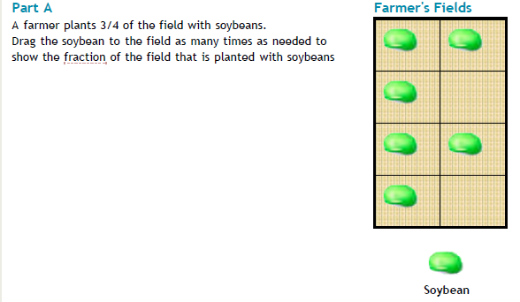
PARCC Item and Task Prototypes – Grade 3 Mathematics

Slide 18
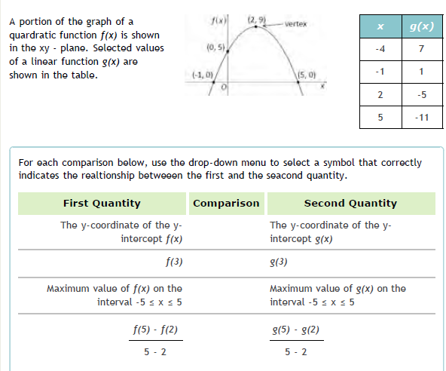
PARCC Item and Task Prototypes – High School Mathematics

Slide 19
Example - Mathematics
3rd Grade Standard: Compare fractions with the same numerator or the same denominator by reasoning about their size. Recognize that comparisons are valid only when the fractions refer to the same whole.
Place these fractions in order from least to greatest
5 , 1 , 9 , 3 , 7
12 12 12 12 12
12 , 12 , 12, 12 , 12
5 1 9 3 7

Slide 20
What to Expect
Fewer but more comprehensive concepts per grade level (no longer teaching concepts in isolation)
More in-depth evidence of learning
Less repetition of content from grade to grade
Most likely an initial dip in performance
Hopefully overtime, greater lifelong retention of learning

Slide 21
Other Possible Expectations
Modeling in mathematics
Assumed use to technology
Reading informational text
Exemplars from science, math and social studies
Next Generation Science Standards
Science and Engineering Practices
Strand – Waves and Their Applications in Technologies for Information Transfer

Slide 22
Monitoring and Support for District Readiness
Monthly each district reports their readiness to implement the Common Core State Standards
http://www.flccss.org/

Slide 23
Questions?

