Slide 1
Using Department of Defense Architectural Framework (DODAF) to Identify Initial Training System Requirements
INCOSE Meeting
January 22, 2015
Orlando, FL
Dr. Dennis Duke
Florida Institute of Technology
Graduate School of Business
Orlando, FL
dduke@fit.edu

Slide 2
Overview
Goal
Sample Projects
Typical Approach to Front End Analysis (FEA)
Issues with Typical Approach
Recommended Approach
Top Down Functional Analysis (TDFA)
Applying DODAF
Summary

Slide 3
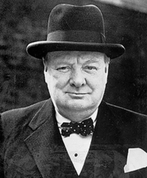
“A good speech should be like a woman's skirt; long enough to cover the subject and short enough to create interest.”
Winston Churchill

Slide 4
Goal
Describe a process for conducting a Front End Analysis (FEA) to identify initial training system requirements for new weapon system prior to involvement of the traditional Instructional Systems Development (ISD) methodology / training device (simulator) engineering design

Slide 5
Examples of Where This Process Was Used
US Navy P-8A Poseidon Training System
Dept of Energy Robotic Operations for Chernobyl Nuclear Reactor Building 4
Joint US Army/US Navy Aerial Common Sensor (ACS) Program

Slide 6

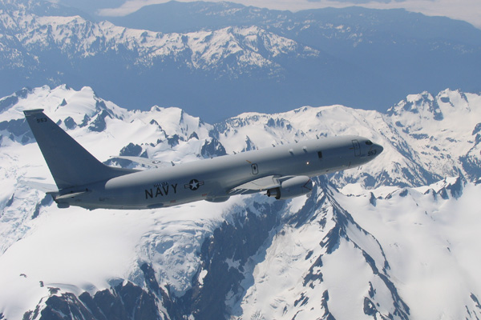
US Navy P-8A Poseidon
Training System Design
U.S Navy P-8A Poseidon in flight
P-8A Production Line
The design of unique training system applications for P-8A operators

Slide 7
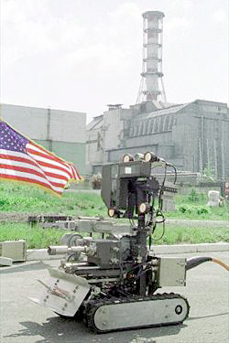
Robotic Operations for Chernobyl Unit 4 Nuclear Reactor
Pioneer is a remote reconnaissance system for structural analysis of the Chornobyl Unit 4 reactor building.
Its major components are:
A teleoperated mobile robot for deploying sensor and sampling payloads
A mapper for creating
photorealistic 3D models
of the building interior
A coreborer for cutting &
retrieving samples of structural
materials
A suite of radiation and
other environmental sensors.

Slide 8
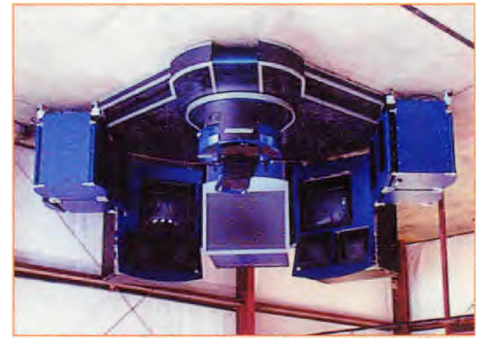
ROBOCON Operator Station
US Department of Energy
Federal Energy Technology Center (FETC)
Morgantown, West Virginia
November 1998
Development of robotic system training for teleoperators, advanced teleoperators, and autonomous systems in support of Operating Engineers National HAZMAT Program (OENHP)

Slide 9
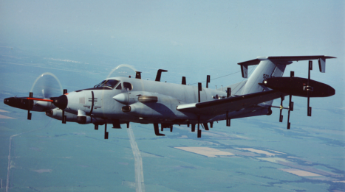
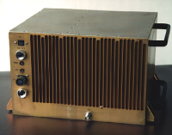
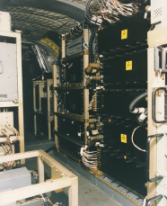

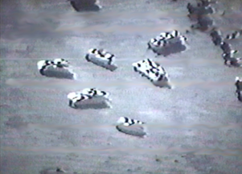
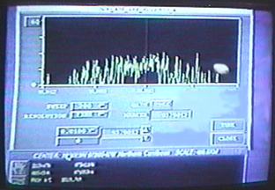
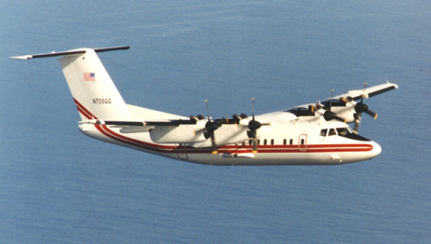
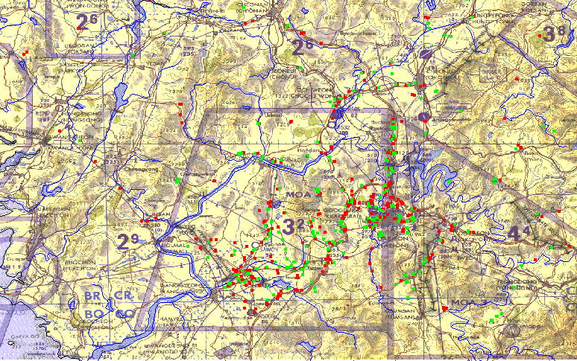
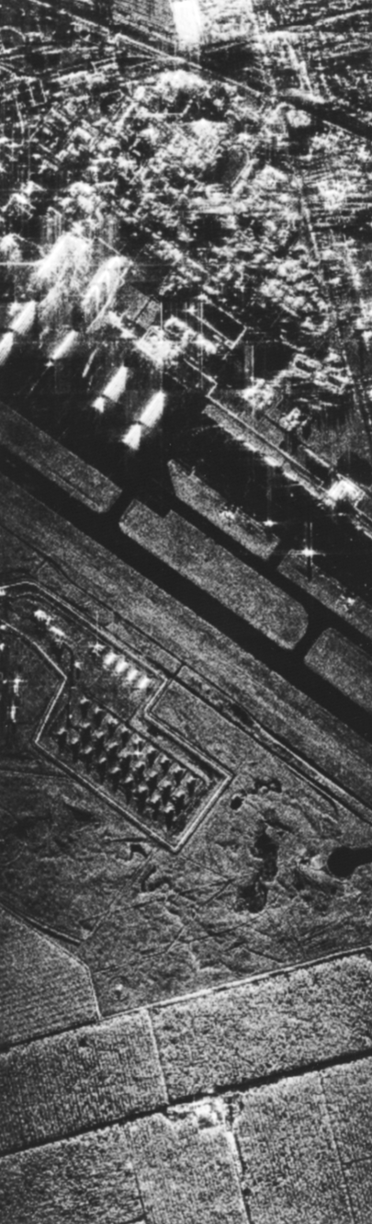
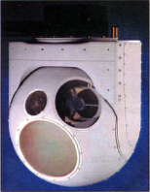
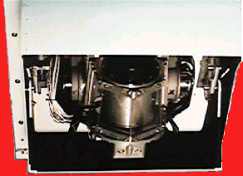
Aerial Common Sensor Program
EP-3
COMINT
GUARDRAIL/Common Sensor
NCCT
ELINT
Real-Time Targeting Support
Worldwide Self-Deployability
Multi-INT - SIGINT, IMINT, MASINT
Interoperable with Joint & National Systems
Enhanced Precision Location
Full Reachback/
Split-Based Operations
Greatly Reduced Footprint
AOCO
COMINT
CHALS
ELINT
Airborne
Data Link
+
Airborne Reconnaissance Low
COMINT
ACS
Airborne
Radar
Data Link
EOIR
Future Manned ISR System

Slide 10

Traditional Analyses
Requirements
Analysis
System
Analysis &
Control
(Operational View)
Function
Analysis
(What)
Design
Synthesis
(Physical View)
Systems Engineering
LSA
Habitability
Available Space and Arrangement
•
Job, Duty & Task
Training
JOB TASK ANALYSIS (JTA)
Descriptions
Job, Duty and Task Descriptions
Operator Scenarios
Task Analysis Data
Berthing and Hygiene Rqmts
•
Operator Scenarios
•
Task Analysis Data
TASK ANALYSIS
LEARNING ANALYSIS
User
User Interface Design Support
Skill and
Aptitude
Rqmts
Share
analysis
results
Interface
MAINTAINERS
Hazard Analysis Results
Design
Support
Feed-
back
Feed
-
Design and Performance
Criteria
Inputs to Hazard Analysis
Skill and Aptitude Rqmts
back
SELECT TASK
FOR TRAINING
SYSTEM
KSA
HIERARCHY
Safety
and Health
Human Factors
Engineering
Personnel
OPERATORS
MEDIA SELECTION
Safety &
Health
Task Analysis Data
DIF
ANALYSIS
OBJECTIVES
E&OH
MEDIA SELECTION RESULTS DRIVE TRAINING DEVICE ACQUISITION
ESOH
Design and Performance
Criteria
Inputs to Survivability Analysis
SA Analysis Results
Duties
SKILL DECAY
Feed-
back
Feed
Share
analysis
results
System, Job and
User Interface design
-
RATE
IDENTIFICATION
Tasks
No. of
Personnel
back
Subtasks
EQUIPMENT IDENTIFICATION
Survivability
Analysis results
No. of Personnel
KSA’s
Survivability
Survivability analysis results
Manpower
Manpower
No. of Personnel
Human System Integration
Training Analysis

Slide 11
Issues with Current Approach
Individual analyses are not adequately integrated
Traditional job analysis seldom considers tie-in to missions systems functions
New system development does not adequately consider:
  Identifying HW/SW requirements to accomplish functions (engineering)
  Identifying OMI/HSI – Human Factors
Information must be adequately defined prior to beginning ISD
    This should be done via a TDFA

Slide 12
Traditional TDFA-to-ISD Relationship
Other System Design Disciplines
Systems Engineering
Human Systems Integration
Human Factors Engineering
Acquisition Logistics
Instructional Systems Development
Test
Items
Develop
Curricula
Conduct
Instruction
Mission
Requirement
Course
Analysis
Top Down Function Analysis
Job
Task
Analysis
Task
Selection
Learning
Analysis
Media
Selection
Training
System
Alternatives
Analysis
Cost
Benefit
Analysis
Fidelity
Analysis
Training
System
Functional
Description
Mission
Analysis
Function
Analysis
Task
Analysis
Reconcile
Tasks
METLs
CONOP
DODAF
Step 1
Step 2
DODAF
Step 3
Step 4
Step 5
Step 6
Training Situation Analysis
DODAF Models
Tactical Situations
12

Slide 13
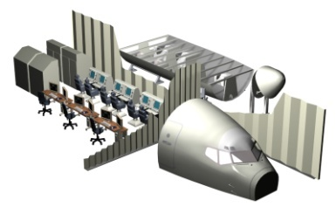
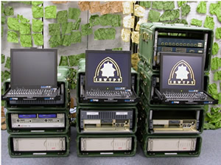
Recommended Approach
FRONT END
Requirements
TDFA
DESIGN REFERENCE MISSION
DODAF / CDD
MISSIONS (UJTL / UATL / UNTL / METL)
SYSTEM FUNCTIONS
NOTIONAL TASKS (Individual, Team
and Collective)
MANPOWER ESTIMATE
TRAINING SYSTEM PLANS
SECURITY (HW/SW/FAC)
Weapons Systems
Trainer (WST)
Part Task Trainers
Electronic Classroom
JOB TASK ANALYSIS (JTA)
TASK ANALYSIS
LEARNING ANALYSIS
MAINTAINERS
Requirements
SELECT TASK
FOR TRAINING
SYSTEM
KSA
HIERARCHY
OPERATORS
MEDIA SELECTION
DIF
ANALYSIS
OBJECTIVES
JOBS (POSITION)
DUTIES
TASKS
• KSA
• TOOLS
SUBTASKS
MEDIA SELECTION RESULTS DRIVE TRAINING DEVICE ACQUISITION
HSI
SKILL DECAY
HSI CONSIDERATIONS
VCAP ANALYSIS
TASK STACKING
(Cognitive Overload)
TRADE-OFFS
AUTOMATION
RATE
IDENTIFICATION
EQUIPMENT IDENTIFICATION
Logistics Support Analysis (LSA)
SUPPORTABILITY REQUIREMENTS
REDUCE SUPPORT COSTS
SUPPORT RESOURCES
SUPPORT DATA

Slide 14
TDFA – Mission Analysis Phase
  Identifies/Documents Mission Tasks
    Universal Naval Task List (UNTL)
    Mission Essential Tasks (METs)
  Documents primary/secondary platform missions that are derived from
    Capability Development Document (CDD)
    Initial Capabilities Document (ICD)
    Performance Based Specification (PBS)
  Creates Alignment
    Provides audit trail
    Mission-function-task
  Identifies the scope of training system
  Identifies draft MOE/MOPs (high level)
    Considers readiness evaluations
    Capabilities Based Matrix (Navy)

Slide 15
JCIDS Documents
Initial Capabilities Document (ICD)
  Identifies a capability gap or other deficiency
  Describes evaluation of DOTMLPF approaches
  Support AoA, Concept Refinement and Milestone A
  Not updated once approved
Capability Development Document (CDD)
  Identifies operational performance attributes of proposed system
  System specific, applies to single increment (in an evolutionary program)
  Results from Technology Development and supports Milestone B
  Updated or rewritten for subsequent increments
Notes:
.

Slide 16
JCIDS Documents (cont’d)
Capability Production Document (CPD)
  Identifies production attributes for a single increment of a program
  Prepared during System Development and Demonstration
  Rewritten for each increment in a evolutionary program
Capstone Requirements Document (CRD)
  Describes overarching thresholds/goals and standards in functional areas
  Especially for family-of-systems or system-of-systems approaches
  Developed only at JROC direction
  Eventually to be replaced by integrated architectures

Slide 17
TDFA – Function Analysis Phase
  Identifies functions required to satisfy primary and secondary missions
  Documents high level performance measures for each function
    Mission Essential Tasks (METs)
    Tactical Situations (TACSITs) Scenarios
  Defines operational relationships between functions
Notes:
Dennis

Slide 18
TDFA – Function Analysis Phase
Should Use Department of Defense Architecture Framework (DODAF)*
  What is an architecture
    “…The fundamental organization of a system embodied in its components there relationships with each other, into the environment, and the principals' guiding its design and evolution.”
    IEEE STD 1471, 2000
*MODAF /UPDM also considered
Notes:
Dennis

Slide 19
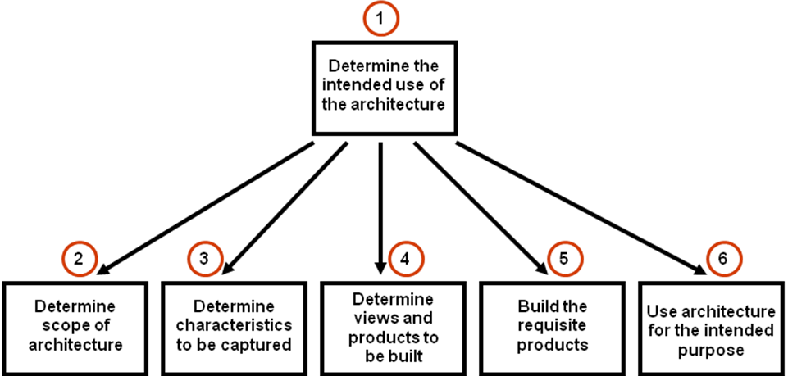
6-Step DODAF Process
Notes:
Dennis

Slide 20
DODAF - Step 1
Analyze Platform CONOP
  Must consider Mission Essential Tasks
  (serves as “high-level” foundation)
  Derived from DODAF OV-1 Views
  Graphically depicts TACSITs
  Creates different mission scenarios
  Requires determination of functions necessary to accomplish mission

Slide 21
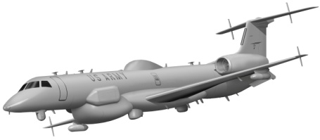
MISSIONS
Strategic National
Strategic Theater
Operational
Tactical
T
T
T
T
T
T
T
T
T
T
T
T
ARMY
NAVY
Combat
Battle Group
REQUIREMENTS
Scenario 1
Scenario 2
FUNCTIONS
SYSTEMS ON-BOARD
Human(s)
Systems (automated)
Human(s)
DESIGN SYNTHESIS
Engineering Solutions
HSI IMPLICATIONS
SOLDIER
SAILOR
Other
Other
Abilities
Knowledge
Knowledge
Abilities
Skills
Skills

Slide 22
NMETL
AMETL
MISSIONS
MISSIONS
REQUIREMENTS
FUNCTIONS
FUNCTIONS
ORGANIZATIONAL
DESIGN
ENGINEERING
ENGINEERING
LOGISTICS
LOGISTICS
WORKLOAD
TASKS
TASKS
MANPOWER
ESTIMATION
PERSONNEL
HABITABLTY
SURVIVABLTY
HUM FACTORS
MANPOWER
TRA INING
SAFETY
MANPRINT
NTSP
STRAP
Notes:
SLIDE ILLUSTRATES HOW THE TOP DOWN FUNCTIONAL ANALYSIS (TDFA) ESTABLISHES THE FOUNDATIONAL AUDIT TRAIL THAT ALLOWS ALL DISCIPLINES (ENGINEERING, LOGISTICS, HSI, ETC.) TO BE CONNECTED TO THE METL (MISSION ESSENTIAL TASK LIST). THIS IS IMPORTANT BECAUSE EACH METL HAS ASSOCIATED CONDITIONS AND STANDARDS THAT CAN BE USED TO ESTABLISH METRICS/MEASURES (MOE, MOP) AT VARIOUS LEVELS OF ORGANIZATIONAL HIERARCHY (WINGS-SQUADRONS-INDIVIDUALS, ETC.)
IN THE TDFA – THE ANALYST DETERMINES THE FUNCTIONS BASED UPON THE REQUIREMENTS ESTABLISHED BY THE MISSIONS (MISSION ESSENTIAL TASKS – BOTH ARMY AND NAVY). THESE MISSION REQUIREMENTS, ALONG WITH THE UNIQUE FUNCTIONS DEEMED NECESSARY TO SUPPORT THE MISSION UNDER VARIOUS CONDITIONS AND TO VARIOUS STANDARDS, ARE CONSIDERED TO DETERMINE THE OPTIMAL ORGANIZATIONAL DESIGN (NUMBER OF SQUADRONS, LOCATION, MAINTENANCE REQUIREMENT, ETC.). ONCE AN ORGANIZATIONAL DESIGN IS ESTABLISHED THEN AN ACCURATE MANPOWER ESTIMATION CAN BE MADE.
THE PURPOSE OF THE FUNCTIONAL ALLOCATION IS TO DETERMINE THE TYPE OF TASKS (HARDWARE, SOFTWARE, HUMAN) NEEDED TO SUCCESSFULLY ACCOMPLISH THE VARIOUS FUNCTIONS. THE KEY TO THE TDFA TEMPLATE (REPRESENTED BY THE PURPLE BACKGROUND BOX) IS THAT BOTH ARMY AND NAVY WILL USE THE SAME PROCESS TO DETERMINE MISSIONS, FUNCTIONS,AND TASKS. THIS WILL ALLOW VALID COMPARISONS TO BE MADE IN ORDER TO DETERMINE COMMONALITY IN TASKS (THUS AFFECTING TRAINING PIPELINES). IN ADDITION, THE ENGINEERING AND LOGISTICS DISCIPLINES CAN USE THE TEMPLATE TO STRUCTURE A COMMON DATABASE FOR COLLECTING NEEDED INFORMATION DURING DESIGN DEVELOPMENT AND LIFE CYCLE SUPPORT OF THE AIRCRAFT. FOR EXAMPLE, FUNCTIONS ARE ACCOMPLISHED BY HARDWARE/SOFTWARE SYSTEMS (ENGINEERING) WHICH ARE OPERATED AND MAINTAINED BY HUMAN TASKS (HSI AND LOGISTICS).

Slide 23
NAVY-ARMY TDFA Comparison for ACS
NMETL
AMETL
Missions
Missions
Functions
Functions
Tasks
Tasks
Common Tasks

Slide 24
ACS Operational Tasks
NUMBER
OF TASKS
C O R E
T A S K S
3
σ
2
σ
1
σ
1
σ
2
σ
3
σ
ARMY
UNIQUE
NAVY
UNIQUE
TASK CHARACTERISTICS

Slide 25
ACS Primary Curriculum
NAVY UNIQUE
SOLDIERS &
SAILORS
C O R E T A S K S
ARMY UNIQUE
Our Idea/Plan
After tasks are selected for training they are incorporated into a modular curriculum
Modules need not be equal in length/content
Depending on assignment, individual (soldier or sailor) ,ay study different modules
Training simulators would be the same but would have different types of scenarios

Slide 26


Concept of Operation – OV-1
IBS
TCA
GPS
Joint
Aircraft
AOIO
Xyz Mbs
CDL JTRS/VOX
CDL Mbs/JTRS/VOX
CDL xyz Mbs
Enemy Air
GIG
DETECTION
Enemy Naval
JTRS/VOX
Teleport
Enemy C3
T-1/E-1
COMMS/
DATA LINK
Enemy Ground/ AIRDEF
DCGS-N
FIST
MCS-21

Slide 27
MISSIONS
Strategic National
Strategic Theater
Operational
Tactical
FEEDBACK
T
T
T
T
T
T
T
T
T
T
T
T
FEEDBACK
ARMY
NAVY
Combat
Battle Group
REQUIREMENTS
Scenario 1
Scenario 2
FUNCTIONS
SYSTEMS ON-BOARD
Human(s)
Systems (automated)
Human(s)
DESIGN SYNTHESIS
Engineering Solutions
HSI IMPLICATIONS
SOLDIER
SAILOR
Other
Other
Abilities
Knowledge
Knowledge
Abilities
Skills
Skills

Slide 28
DODAF - Step 2
Identify Architectural Scope of Weapon System
  Example: surveillance mission
    What components (equipment) of specific systems (radar) will be impacted and what will require human interface
  Derived from various DODAF Views
    Nodes/Systems Connectivity Identified (OV-2)
    IDEF Inputs & Outputs (OV-5)
    Identifies Operational Events (OV-6c)
    Identifies System Interfaces (SV-1)
    Helps identify OMI interfaces (VCAP analysis)
    1st determination of human tasks
Notes:
Dennis

Slide 29
IBI Use Case
Development Approach
MMA DRM TACSITs
IBI Strategy to Task Analysis
Level 0
Root Tasks
Gov’t
Lead
Level 1
Use Cases
C4ISP
(OV-2s & IERs)
MMA Training
TDFA
Level 1
Level 1
Branch Tasks
Level 1
MMA ORD
QFD
Level 2
MMA System
Gov’t Transition
to Boeing Lead
JMET
VP NMETL
Functional Flow Diagrams
Level 3
MMA Segment
Use Case Working Group (Gov’t & Boeing), Engineers, SMEs, & FIT
Boeing
Lead
Level 4 Design
MMA Design
Level “n “Design

Slide 30
Operational Node Connectivity Description OV-2
Information Exchange 1
Node
B
Activity 1
Activity 2
Information Description
  Name Identifier
  Definition
  Media
  Size
  Units
Information Exchange Attributes
  Frequency, Timeliness,
  Throughput
  Security
  Interoperability
  Requirements
Information Source
Information Destination
Node
A
Node
C
Activity 1
Activity 2
Activity 1

Slide 31
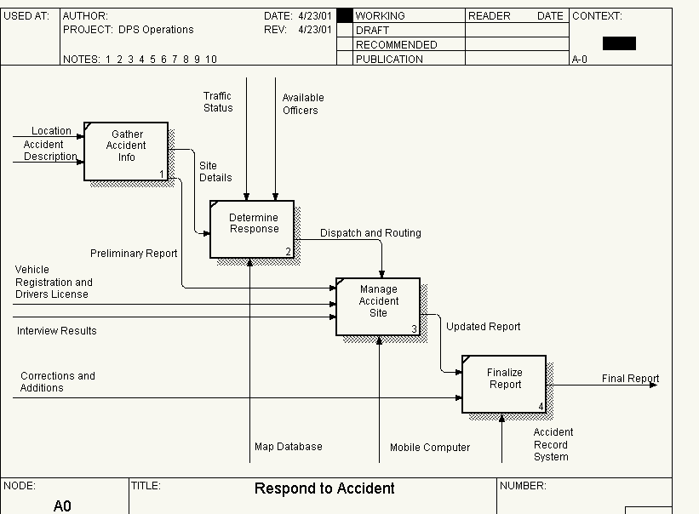
Operational Activity Model OV-5

Slide 32
Operational Event-Trace Description
OV-6c
Nodes
Node 1 Node 2 Node 3
Events/Times
EVENT 1
Time 1
Time 2
Time 3
Time 3’
Time n
(Formula relating Time 1 to Time 2)
EVENT 2
EVENT 3
(Formula relating Time 3 to Time 3’)
EVENT 4
EVENT 5
EVENT 6
EVENT 7
EVENT 8

Slide 33
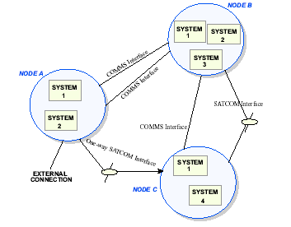
System Interface Description SV-1
33

Slide 34
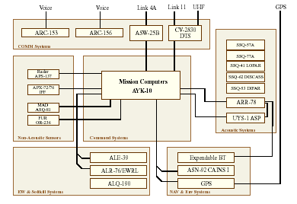
SV-1 System Interface Description
Intranodal Perspective

Slide 35
DODAF - Step 3
Identify Task Data Requirements
  Establishes template to identify tasks done during missions
    TACSIT – Conditions are identified
    METS – Standards are developed using measures identified in MET
    Key is to dissect mission/function Standards identified down to collective/individual human tasks
      Uses Capabilities Based Matrix (CBM)
      Use Personnel Qualification Standards (PQS)
Notes:
Dennis

Slide 36
Approach – Correlation of Mission and
System Functions
(Mission Function to System Function Matrix; DoDAF SV-5)
Correlation

Slide 37
Mapping Matrix
 | System Function 1 | System Function 2 | System Function 3 | System Function 4 | System Function N
Mission Function 1 |  |  | X | X
Mission Function 2 | X | X
Mission Function 3 | X | X | X
Mission Function N |  |  |  | X | X
Level 1
Use Cases
Mission Functions
 | Mission Function 1 | Mission Function 2 | Mission Function 3 | Mission Function 4 | Mission Function N
Op Activity 1 | X |  | X
Op Activity 2 |  | X |  |  | X
Op Activity 3 | X |  |  | X | X
Op Activity N |  | X |  | X
Boeing FFD Correlation Matrix
Op Activities
Mapping Matrix

Slide 38
Approach – Use Case Integration Technique

Slide 39
Analysis Flow

Slide 40
Approach – Mission Functions
(Operational Perspective*)
1.0
1.0
2.0
2.0
3.0
3.0
4.0
4.0
5.0
5.0
7.0
TRANSIT
7.0
PREPARE
TRANSIT
PREPARE
RECOVER
PLAN
RECOVER
PLAN
TO
TO
PERFORM
PERFORM
TRANSIT
OR
TRANSIT
OR
OR
OR
AND
AND
OR
OR
OR
FOR
OR
FOR
FROM
MISSION
FROM
MISSION
MISSION
MISSION
MISSION
MISSION
TO BASE
MISSION
TO BASE
MISSION
MISSION
AREA
MISSION
AREA
Decomposition
6.0
6.0
PROTECT
PROTECT
AIRCRAFT
8.0
AIRCRAFT
8.0
MAINTAIN
MAINTAIN
OR
AIRCRAFT
OR
AIRCRAFT
Root-Level Mission Flow
4.1
4.1
4.2
4.2
4.3
4.3
4.4
4.4
4.5
4.5
4.6
4.6
4.7
SEARCH
4.7
SEARCH
CLASSIFY
CLASSIFY
TRACK
REPORT
TRACK
REPORT
LOCALIZE
LOCALIZE
REPORT
FOR
REPORT
FOR
OBJECT
OBJECT
TARGETS
TARGETS
ATTACK
AND
ATTACK
AND
OR
OR
OR
OR
OR
OR
OR
ON
OR
ON
CONTACT
CONTACT
OFF
CONTACT
OFF
CONTACT
OF
OF
OF
OF
TARGET
STATION
TARGET
STATION
S
S
STATION
S
STATION
S
INTEREST
INTEREST
INTEREST
INTEREST
“4.0 Perform Mission” Mission Flow
“4.2 Search for Contacts” Mission Flow
Allocation
4.2.1.1
4.2.1.2
4.2.1.3
4.2.1.4
4.2.1.5
4.2.1.6
SELECT
SELECT
DETECT
DISPLAY
EVALUATE
RECORD
RADAR
OR
DISPLAY
RADAR
RADAR
RADAR
AND
RADAR
SETTINGS
PARAMET
RETURNS
RETURNS
RETURN
CONTACT
ERS
S
Radar Operator
Radar Operator
Radar
MCDS
Radar Operator
MCDS
“4.2.1 Detect Radar Contacts” Mission Flow
*Example only: Operational Activity Model (MMA OV-5)

Slide 41
Approach – System Functions
(Design Perspective*)
MMA System
CI / CSCI level
System Use Cases
Mission Functions are the focus for SFR, and System Functions are detailed at PDR
*Example only: System Functional Hierarchy (MMA SV-4)

Slide 42
DODAF - Step 4
Data Collection
  Obtained via workshop with facilitators
  Participants are a stratified sample of SME’s
    Managers – those who are familiar with CONOPS of new platform (missions)
    SME position specialists
      Legacy system operators (if applicable)
      System design engineers
    Facilitator “Tells the story”
      Asks for SMEs to fill in the gaps
      Tries to obtain as much detail as possible
      Use TMs, PQS manual, CBM, etc. for reference

Slide 43
Template for Collecting Scenario Data

Slide 44
DODAF - Step 5
Data Verification
Do the tactical scenarios accurately represent actual Missions?
Is scenario realistic?
Are all correct functions that must be performed in support of missions identified?
Does technical DODAF data (OV-2, OV-5, OV-6c) correlate with information obtained during “Story Telling” scenario exercise?
Can satisfactory performance (MOE) be documented from information obtained from measures identified in METLs and conditions contained in TACSITs?
Can preliminary MOPs be developed and associated with operational equipment?
Notes:
Dennis

Slide 45
ZAF with P-8A (MMA) Architecture and
DoDAF Products

Slide 46
DODAF - Step 6
Documentation of Results
Hardware, software & human tasks can be written for each piece of equipment with conditions (obtained from TACSITs) to what standards (obtained from METL, TM, PQS, etc.)
Provides Functional Task Analysis
Used to Develop Job Task Analysis

Slide 47
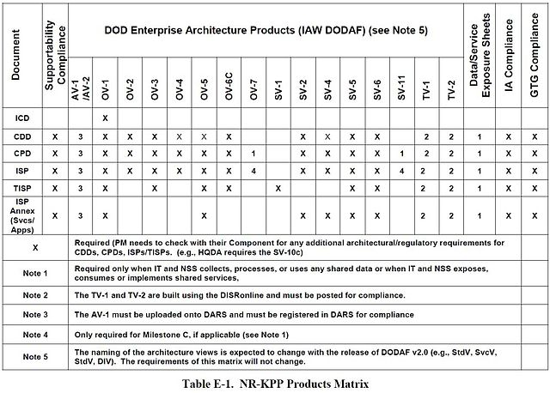
http://commons.wikimedia.org/wiki/File:NR-KPP-ProductsMatrix.jpg#mediaviewer/File:NR-KPP-ProductsMatrix.jpg">NR-KPP-ProductsMatrix</a>" by DoD - CJCSI 6212.01E. Licensed under Public Domain via <a href="//commons.wikimedia.org/wiki/">Wikimedia Commons</

Slide 48
Job Task Analysis
Uses information from function analysis to develop Job/Task Analysis
What is a task?
Selecting tasks for training (process)
Identifying subtasks (human)
  Knowledge and skill acquisition
Foundation for learning analysis

Slide 49
Summary
DODAF version 2.0 advocates that the “…decision maker be actively involved in the acquisition development process in support architectural decision development.” (DODAF, HDBK Vol 2.0 Page 9)
  Engineers developing DODAF (engineering design)
  Trainers determining human tasks in various scenarios
  Trainers communicate information to engineers
  Engineers incorporate into system
This is an example of a process that was used on a new platform acquisition. Considering training early will improve the effectiveness of the overall training program
Attention to training detail must be made in the functional analysis that is done prior to the traditional Job Analysis (ISD)

Slide 50
TDFA Mission-Based Hierarchy
MISSIONS
The Mission-based Hierarchy Serves as a foundation for all of the HSI domains.
BUT, it can also serve as a foundation for systems engineering and acquisition logistics – thus everything is connected to the mission!
THE MISSION
DRIVES EVERYTHING !
FUNCTIONS
TASKS
MANPOWER
PERSONNEL
TRAINING
SAFETY
HAB
I
TABLTY
SURVIVABLTY
HUM FACTORS
OCC
HEALTH
Systems Engineering
Acquisition Logistics
HSI/MANPRINT Domains

Slide 51
All Viewpoints
Describes the overarching aspects of architecture context that relate to all viewpoints
AV-1 Overview and Summary Information
  Describes a Project's Visions, Goals, Objectives, Plans, Activities, Events, Conditions, Measures, Effects (Outcomes), and produced objects.
AV-2 Integrated Dictionary
  An architectural data repository with definitions of all terms used throughout

Slide 52
Capabilities Views
Articulates the capability requirements, the delivery timing, and the deployed capability.
CV-1 Vision Addresses the enterprise concerns associated with the overall vision for transformational endeavors and thus defines the strategic context for a group of capabilities. The purpose of the CV-1 is to provide a strategic context for the capabilities described in the Architecture Description.
CV-2 Capability Taxonomy Captures capability taxonomies. The model presents a hierarchy of capabilities. These capabilities may be presented in the context of a timeline. The CV-2 specifies all the capabilities that are referenced throughout one or more architectures.
CV-3 Capability Phasing The planned achievement of capability at different points in time or during specific periods of time. The CV-3 shows the capability phasing in terms of the activities, conditions, desired effects, rules complied with, resource consumption and production, and measures, without regard to the performer and location solutions.
CV-4 Capability Dependencies
The dependencies between planned capabilities and the definition of logical groupings of capabilities.

Slide 53
Capabilities Views
CV-5 Capability to Organizational Development Mapping
The fulfillment of capability requirements shows the planned capability deployment and interconnection for a particular Capability Phase. The CV-5 shows the planned solution for the phase in terms of performers and locations and their associated concepts.
CV-6 Capability to Operational Activities Mapping A mapping between the capabilities required and the operational activities that those capabilities support.
CV-7 Capability to Services Mapping A mapping between the capabilities and the services that these capabilities enable.

Slide 54
Operational Views
Includes the operational scenarios, activities, and requirements that support capabilities
OV-1 High-Level Operational Concept Graphic
  The high-level graphical/textual description of the operational concept.
OV-2 Operational Resource Flow Description
  A description of the Resource Flows exchanged between operational activities.
OV-3 Operational Resource Flow Matrix
  A description of the resources exchanged and the relevant attributes of the exchanges.
OV-4 Organizational Relationships Chart
  The organizational context, role or other relationships among organizations.
OV-5a Operational Activity Decomposition Tree
  The capabilities and activities (operational activities) organized in a hierarchal structure.
OV-5b Operational Activity Model
  The context of capabilities and activities (operational activities) and their relationships among activities, inputs, and outputs; Additional data can show cost, performers or other pertinent information.
OV-6a Operational Rules Model
  One of three models used to describe activity (operational activity). It identifies business rules that constrain operations.
OV-6b State Transition Description
  One of three models used to describe operational activity (activity). It identifies business process (activity) responses to events (usually, very short activities).
OV-6c Event-Trace Description
  One of three models used to describe activity (operational activity). It traces actions in a scenario or sequence of events

Slide 55
Project Views
Details dependencies among capability and operational requirements, system engineering processes, systems design, and services design within the Defense Acquisition System process
PV-1 Project Portfolio Relationships. It describes the dependency relationships between the organizations and projects and the organizational structures needed to manage a portfolio of projects.
PV-2 Project Timelines A timeline perspective on programs or projects, with the key milestones and interdependencies.
PV-3 Project to Capability Mapping A mapping of programs and projects to capabilities to show how the specific projects and program elements help to achieve a capability.

Slide 56
Services Views
Articulates the applicable operational, business, technical, and industry policies, standards, guidance, constraints, and forecasts that apply to capability and operational requirements, system engineering processes, and systems and services.
SvcV-1 Services Context Description The identification of services, service items, and their interconnections.
SvcV-2 Services Resource Flow Description A description of Resource Flows exchanged between services.
SvcV-3a Systems-Services Matrix The relationships among or between systems and services in a given Architectural Description.
SvcV-3b Services-Services Matrix The relationships among services in a given Architectural Description. It can be designed to show relationships of interest, (e.g., service-type interfaces, planned vs. existing interfaces).
SvcV-4 Services Functionality Description The functions performed by services and the service data flows among service functions (activities).
SvcV-5 Operational Activity to Services Traceability Matrix A mapping of services (activities) back to operational activities (activities).
SvcV-6 Services Resource Flow Matrix It provides details of service Resource Flow elements being exchanged between services and the attributes of that exchange.
.

Slide 57
Services Views
SvcV-7 Services Measures Matrix The measures (metrics) of Services Model elements for the appropriate timeframe(s).
SvcV-8 Services Evolution Description The planned incremental steps toward migrating a suite of services to a more efficient suite or toward evolving current services to a future implementation
Svc.V-9 Services Technology & Skills Forecast The emerging technologies, software/hardware products, and skills that are expected to be available in a given set of time frames and that will affect future service development.
SvcV-10a Services Rules Model One of three models used to describe service functionality. It identifies constraints that are imposed on systems functionality due to some aspect of system design or implementation.
SvcV-10b Services State Transition Description One of three models used to describe service functionality. It identifies responses of services to events.
SvcV-10c Services Event-Trace Description One of three models used to describe service functionality. It identifies service-specific refinements of critical sequences of events described in the Operational Viewpoint

Slide 58
Systems Views
Articulates, for legacy support, the design for solutions articulating the systems, their composition, interconnectivity, and context providing for or supporting operational and capability functions
SV-1 Systems Interface Description The identification of systems, system items, and their interconnections.
SV-2 Systems Resource Flow Description A description of Resource Flows exchanged between systems.
SV-3 Systems-Systems Matrix The relationships among systems in a given Architectural Description. It can be designed to show relationships of interest, (e.g., system-type interfaces, planned vs. existing interfaces).
SV-4 Systems Functionality Description The functions (activities) performed by systems and the system data flows among system functions (activities).
SV-5a Operational Activity to Systems Function Traceability Matrix A mapping of system functions (activities) back to operational activities (activities).
SV-5b Operational Activity to Systems Traceability Matrix A mapping of systems back to capabilities or operational activities (activities).

