Slide 1


INCOSE Wasatch Chapter Meeting
June 13, 2019

Slide 2
Agenda
6:00 – 6:30 | Dinner & Networking
6:30 – 6:45 | Chapter Announcements | Paul White, Chapter President
6:45 – 6:50 | Systems Engineering Council | Dr. David Wetzel, Weber State University
6:50 – 8:00 | INCOSE Certification | Vince Johnston, L-3 Technologies

Slide 3
Introduction
Overview of INCOSE & Wasatch Chapter
New & Renewed Members
ASEP, CSEP, & ESEPs
Chapter Awards
Chapter Leadership
Chapter Website
Chapter Meetings
INCOSE Events

Slide 4

What is INCOSE?
International Council on Systems Engineering
Industry organization for systems engineers
Founded in 1990
Grown to over 11,000 members across U.S. & many parts of the world
Corporate Advisory Board of 99 companies
69 chapters + 6 emerging chapters
http://www.incose.org

Slide 5
What is the INCOSE Wasatch Chapter?
Chartered in January 1997 to serve Utah systems engineering community
  Systems Engineers
  Companies
  Universities
Membership is mostly along “Wasatch Front”
Support Utah systems engineers & companies as we compete in today’s global marketplace
Member society of Utah Engineers Council (UEC)

Slide 6
What is the INCOSE Wasatch Chapter?
Systems Engineering Presentations
Networking
Conferences
Certification
Training
Scholarships

Slide 7
What is the INCOSE Wasatch Chapter?
Air Force Nuclear Weapons Center
BAE Systems
BYU
BYU-Idaho
Defense Acquisition University
Embraer
Embry Riddle Aeronautical University
General Dynamics
General Electric
Hill Air Force Base
KIHOMAC
Kimberly Clark
L-3 Technologies
Lockheed Martin
Northrop Grumman
Rockwell Collins
Siemens
System Solutions
TASC
Utah State University
Weber State University

Slide 8
New Members!
Brian Dold (Embraer)
Rachel Geerlings (Northrop Grumman)
Daniel Martin

Slide 9
Renewed Members!
Angie Harbert (Northrop Grumman)

Slide 10
ASEPs, CSEPs, & ESEPs
ASEP
  Laura Birkhold
  Aaron Borden
  Tim Coda
  John McCrea
CSEP
  William Bearden
  Derek Boddy
  Angie Harbert
  Justin McMurray
  John Metcalf
  Paul Nelson
  David Shook
  David Vickery
  Paul White
ESEP
  Vince Johnston

Slide 11

INCOSE Awards
Gold Circle Award
Most Improved Chapter Award
Outstanding Service Award – Paul White

Slide 12
Chapter Leadership
Name | Officer Role | Company | E-mail Address
Paul White | President | KIHOMAC | Paul.White@kihomac.com
Angie Harbert | Vice President | Northrop Grumman | angie.harbert@ngc.com
Paul Nelson | Secretary | Northrop Grumman | paul.nelson@ngc.com
John Richards | Treasurer | Northrop Grumman | john.richards@ngc.com
Ernest Kyed | Director-at-Large | Northrop Grumman | ernest.kyed@ngc.com
Vince Johnston | Director-at-Large | L3 Technologies | vincent.b.johnston@l3t.com
John McCrea | Director-at-Large | AFNWC/NIAB Hill Air Force Base | john.mccrea.3@us.af.mil
Bylaws are available on the chapter website:
http://www.incose.org/wasatch
(Library and Resources)
Quarterly video-teleconferences to touch base
Officers are required; all are invited.

Slide 13
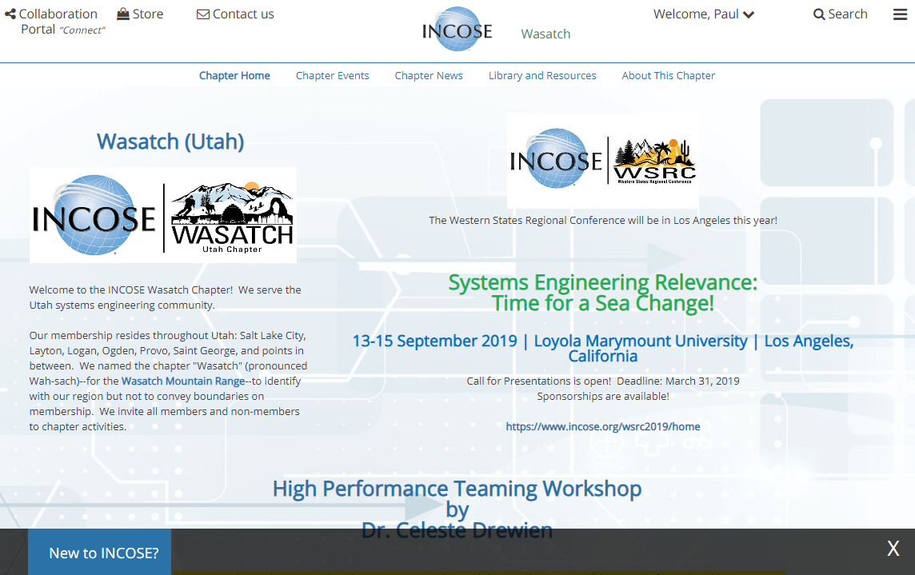
Chapter Website
http://www.incose.org/wasatch

Slide 14
Chapter Meetings
Date | Meeting or Event | Location
6/13 | INCOSE Certification – Vince Johnston, ESEP, L-3 Technologies | KIHOMAC
Mon., 7/8 | INCOSE Wasatch Chapter 3rd Annual Summer Social -- Sponsored by Northrop Grumman | Northrop Grumman Conference Center
8/8 | AIAA/INCOSE Wasatch 3rd Annual August is for Aerospace Event | Roosters - Layton
2nd Thursdays of the month

Slide 15
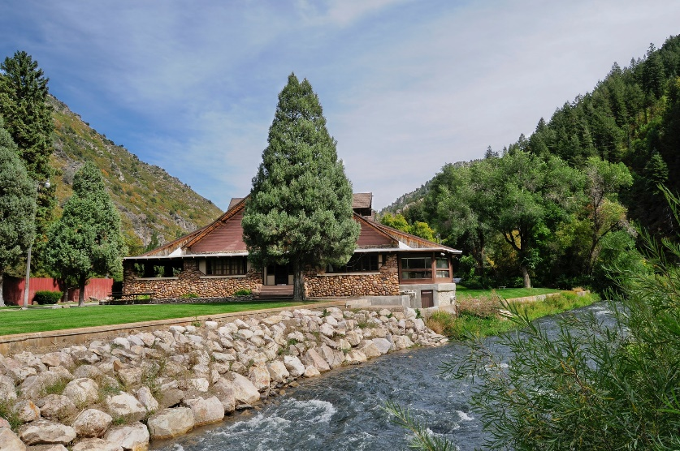


INCOSE Wasatch Chapter 3rd Annual Summer Social
Monday, July 8
6:00 – 9:00 p.m.
Northrop Grumman Conference Center
890 Ogden Canyon
Ogden, UT 84401
Dinner, Cash Bar, & Featured Speakers

Slide 16
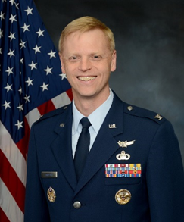
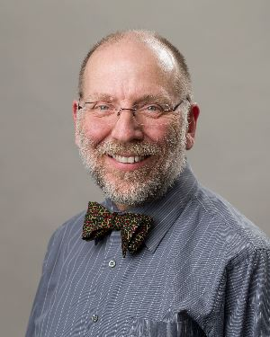
INCOSE Wasatch Chapter 3rd Annual Summer Social
Colonel Luke Cropsey
ICBM Systems Director
Hill Air Force Base
Dr. John E. Sohl, Ph.D.
Professor of Physics
Weber State University

Slide 17
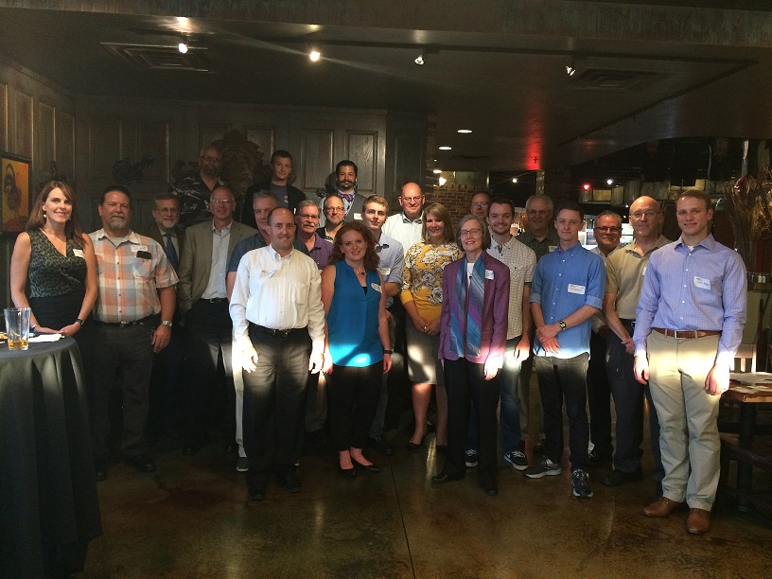
AIAA/INCOSE August is for Aerospace

Slide 18

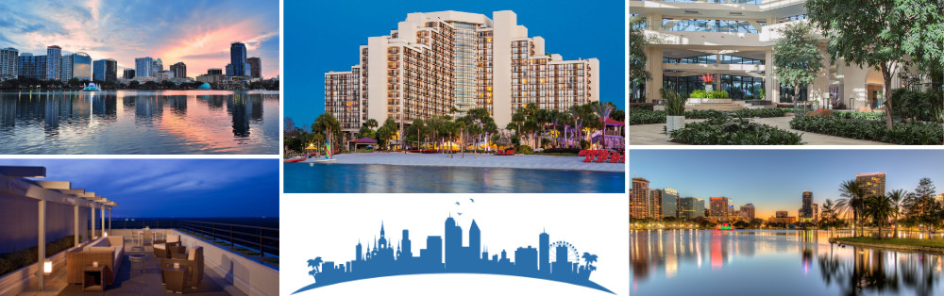
INCOSE 29th Annual International Symposium
https://www.incose.org/symp2019/home

Slide 19

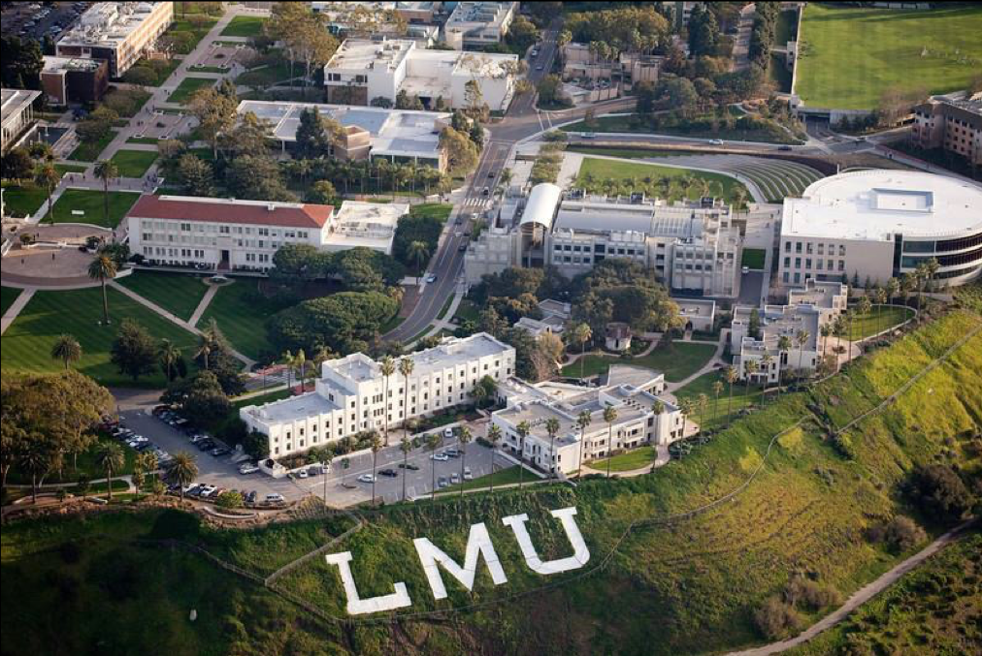
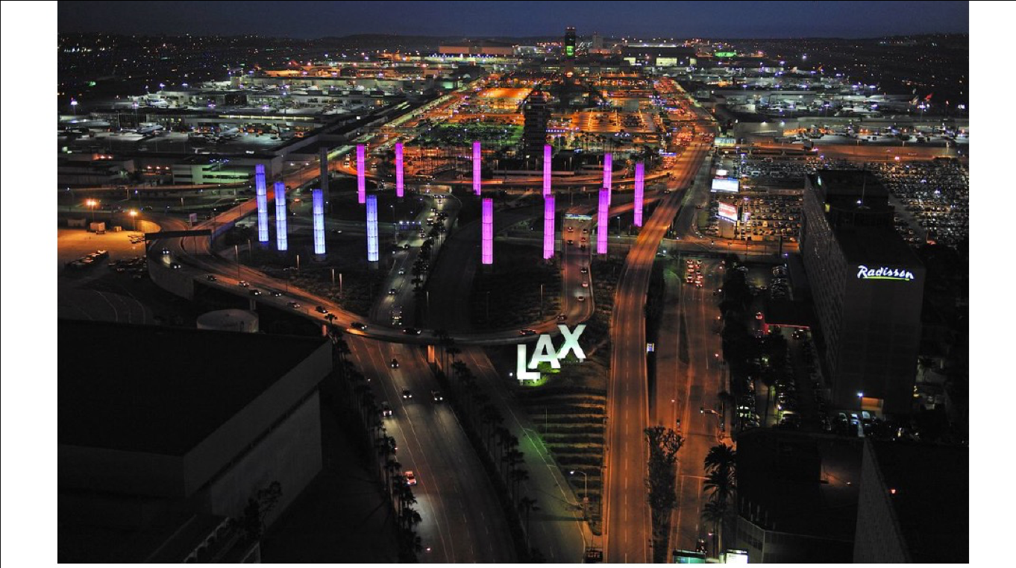
INCOSE Western States Regional Conference
Systems Engineering Relevance: Time for a Sea Change!
September 13-15, 2019
Los Angeles, California
Loyola Marymount University
https://www.incose.org/wsrc2019/home
Opportunities for sponsors or satellite sites

